Slide 1
LabORATORY OF Data Science
Business Intelligence Architectures
Data Science & Business Informatics Degree

Slide 2
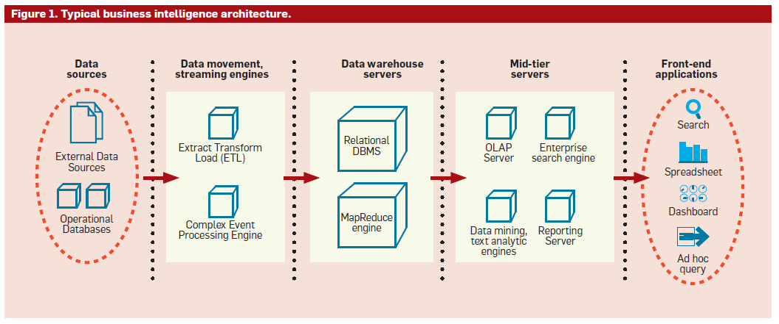
BI Architecture

Slide 3
Data sources
Multiple operational data sources
  Across departments of the organization, and external sources
  Type and formats
    Relational, multidimensional, time-seriers, spatial, text, multimedia, ..
  Issues
    Standards for representations, codes, formats of text files
    Standards for querying relational data sources
    Basic programs for data manipulation
We will study:
  Python access to text files
  Python access to RDBMS

Slide 4
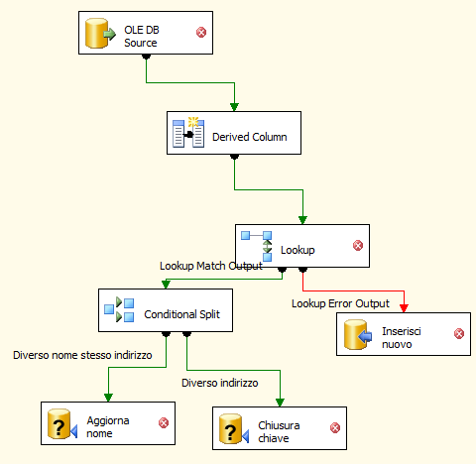
Extract, Transform and Load
ETL (extract transform and load) is the process of extracting, transforming and loading data from heterogeneous sources in a data base/warehouse.
  Typically supported by (visual) tools
We will study:
  SQL Server 2019 Integration Services

Slide 5
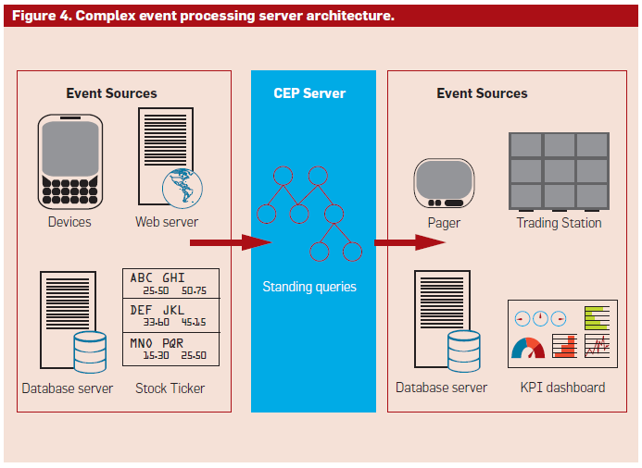
Extract, Transform and Load
Incremental and real-time ETL
  Complex Event Processing (CEP)

Slide 6
Data warehouse
“A data warehouse is a subject-oriented, integrated, time-variant, and nonvolatile collection of data in support of management’s decision-making process.” W.H. Inmon
Data warehousing: the process of building and using a datawarehouse

Slide 7
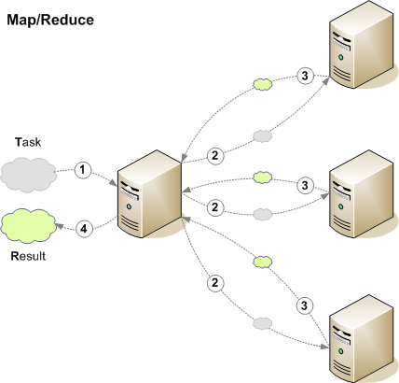
Data warehouse servers
Relational DBMS (RDBMS)
  With specialized index and optmizations
    star-join query, bitmap index, partitioning, materialized views
  We will study:
    SQL Server 2019 with analytic SQL
MapReduce engine
  Big data challenge
    Architect (low-cost) data platform
  Covered by 687AA «Distributed Data Analysis & Mining»

Slide 8
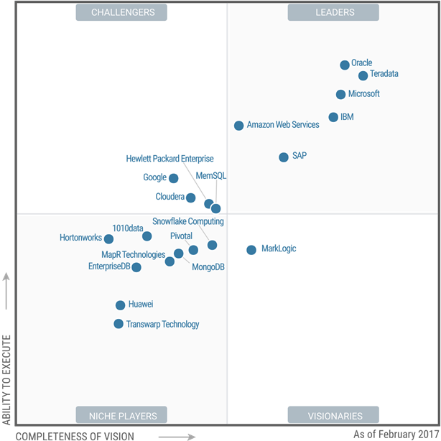
Which DBMS for DW?
Gartner names Microsoft a leader in the Magic Quadrant for Data Management Solutions for Analytics

Slide 9
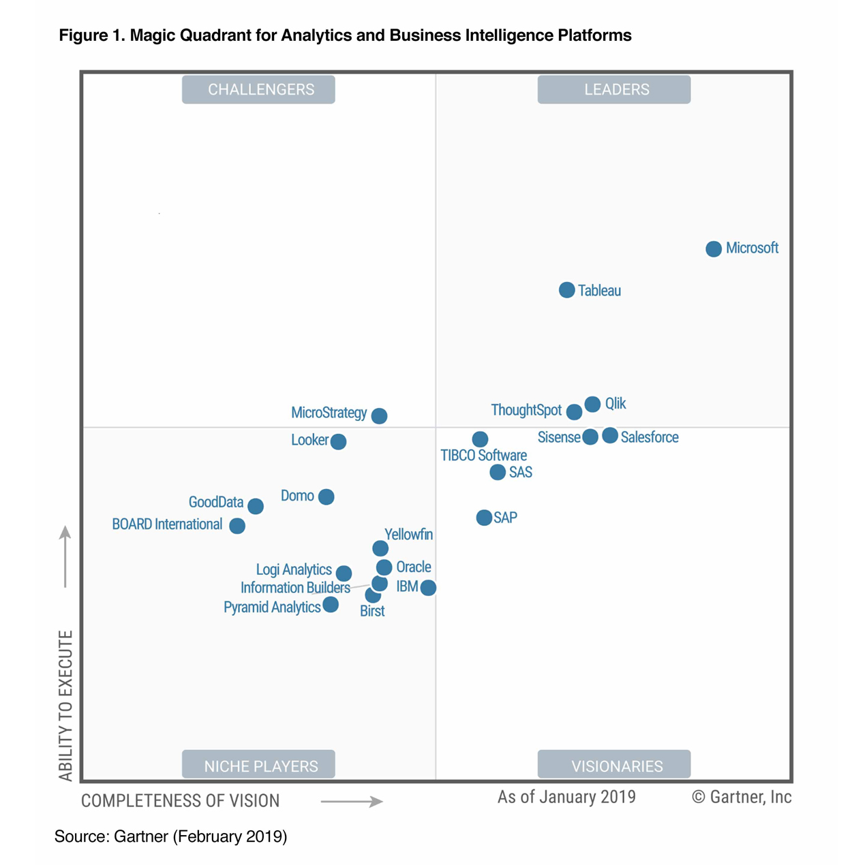
Which BI platform?
2019 Magic Quadrant for Analytics and Business Intelligence Platforms

Slide 10
BI Architecture

Slide 11
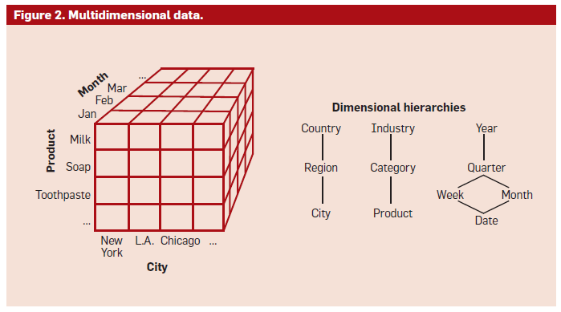
Mid-tier servers
OnLine Analytical Processing (OLAP)
  Provides a multidimensional view of data warehouses
  Pre-compute aggregates and stored:
    in ad-hoc structures (multidimensional OLAP - MOLAP)
    in relational DB (relational OLAP - ROLAP)
    in-memory OLAP
We will study:
  SQL Server 2019 Analysis Services and MDX Query Language

Slide 12
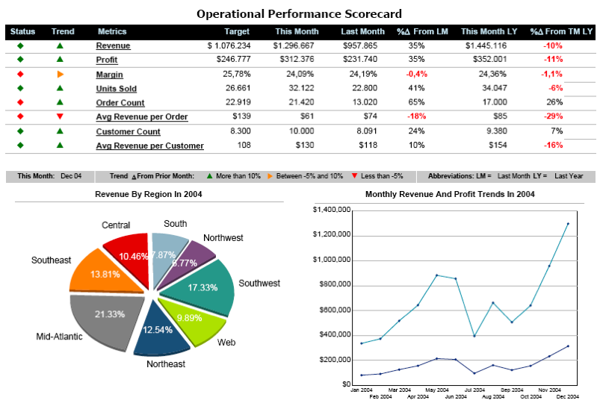
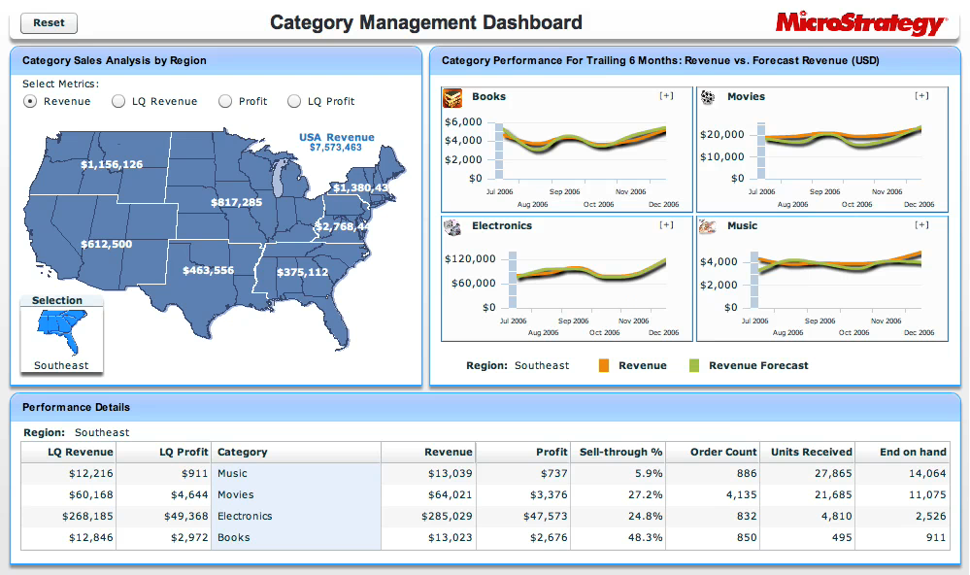
Mid-tier servers
Reporting Servers
  Enable definition, efficient execution, and rendering of reports
  Data is retrieved from datawarehouse or OLAP servers
We will study:
  Microsoft Power BI

Slide 13
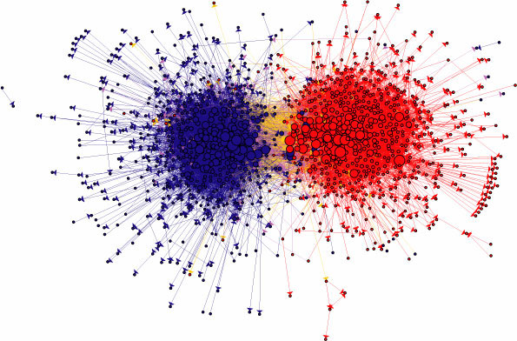
Mid-tier servers
Data/web/text mining servers
  Extract descriptive & predictive models from structured/graph/textual data
We will study:
  Azure Machine Learning
  How to model a DM & ML problem

Slide 14
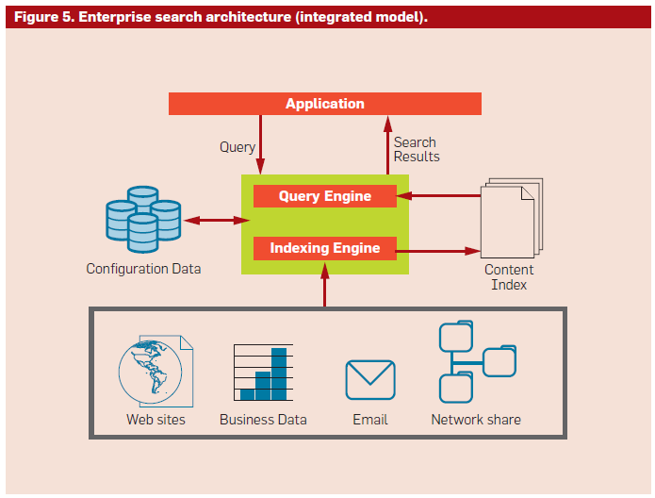
Mid-tier servers
Enterprise Search Engine
  Crawl, index and search by keywords over different types of data
  Covered by 289AA «Information Retrieval»

Slide 15
BI Architecture

Slide 16
Front-end applications
Applications through which users perform BI tasks
  Spreadsheets
    for navigating multidimensional data
    We will study: Excel
  Enterprise portals
    for accessing reports and dashboards
    for searching through query
  GUI
    for accessing mining models
    for exploratory data analysis
    for ad-hoc queries
  Vertical packaged applications for CRM, Supply-Chain, Finance, Opinion mining …
  More specialized tools for building storytellings to produce understandable stories to presents information to the users.
    Covered by 602AA «Visual Analytics»

Slide 17
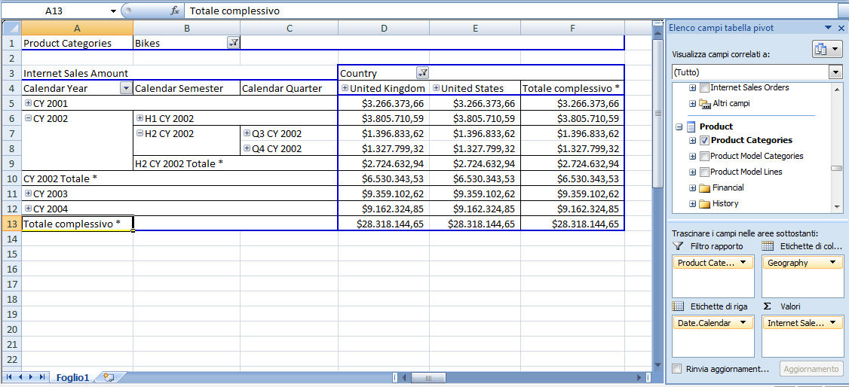
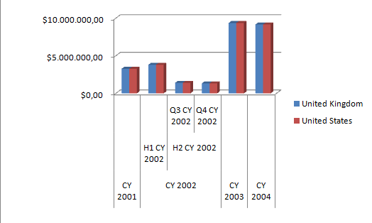
Front-end applications

