Slide 1

JavaScript
Università di Pisa
Davide Morelli
Giuseppe Attardi

Slide 2
history
LiveScript (1995) in Netscape
javascript is a misleading name
started as a scripting counterpart for java in Netscape
battle vs Microsoft
ECMAscript
  current is 6
  coming ES 2017
server side (already present in 1994, now usable)
source: wikipedia

Slide 3
History: WEB
HTML/CSS
JavaScript
source: http://blog.bitops.com/assets/GDC2013_HTML5_Games.pdf

Slide 4
History: the platform grew
HTML/CSS
JavaScript
Canvas2D
SVG
HTML5Audio
source: http://blog.bitops.com/assets/GDC2013_HTML5_Games.pdf

Slide 5
History: grew some more
HTML/CSS
JavaScript
Canvas2D
SVG
HTML5Audio
WebGL
Typed Array
Web Workers
Web Sockets
Fullscreen
source: http://blog.bitops.com/assets/GDC2013_HTML5_Games.pdf

Slide 6
History: let’s get crazy
HTML/CSS
JavaScript
Canvas2D
SVG
HTML5Audio
WebGL
Typed Array
Web Workers
Web Sockets
Fullscreen
WebRTC
  2-way low latency audio, video and data
Web Audio
source: http://blog.bitops.com/assets/GDC2013_HTML5_Games.pdf

Slide 7
History: everything merges together
emscripten
  LLVM to JavaScript
  compile C/C++ into JS that runs on the web
  https://github.com/kripken/emscripten/wiki
  example: http://gnuplot.respawned.com
ASM.JS
  near native JavaScript performance
  http://asmjs.org
source: http://blog.bitops.com/assets/GDC2013_HTML5_Games.pdf

Slide 8
History: server side
recent trend in SV
very effective coupled with nosql
example: nodejs + mongodb

Slide 9
Features of the language
imperative
  if, loops, etc..
loosely typed
dynamic
  everything is an object
  eval
functions are objects
prototype based

Slide 10
JavaScript in two slides
Objects map strings to values (properties):
  var obj = new Object;
  obj["prop"] = 42; => obj.prop
  obj["0"] = “hello”; => obj[0]
Functions are first-class objects:
  function fact(n) {
  return (n == 0) ? 1 : n * fact(n-1);
  }
  fact.desc = "Factorial function";

Slide 11
JS in two slides (2)
So methods are function-valued properties:
  obj.frob = function (n) {
  this.prop += n;
  };
  obj.frob(6); => obj.prop == 48
Permissiveness throughout. Oops.
  grob = obj.frob; => var not necessary
  grob(6); => undefined + 6 == NaN
  prop = “hello”; => reset global prop
  grob(6); => prop == “hello6”

Slide 12
types
string
numbers
booelans
Date
arrays
objects
undefined
null
RegExp, Math, DOM

Slide 13
comparison
==, !=
===, !==
>, >=, <, <=
&&, ||, !
? :

Slide 14
var
dynamic typing
  types associated with values, not variables
    var a = 1;
    console.log(a);
    a = "ciao";
    console.log(a);

Slide 15
statements
blocks
scoping: javascript does NOT have block scope
      var a = 1;
      {
      var a = 2;
      }
      console.log(a);

Slide 16
flow control
if
switch
for
  (more details later..)
while
do

Slide 17
try catch
try … catch
throw
finally

Slide 18
functions
recursion
functions are objects
    var foo = function(a) { return a + 1; }
    var a = foo;
    console.log(a(1));
closures
    var a = 1;
    function foo() { return a; }
    console.log(foo());

Slide 19
Full Lexical Closures
  Y = λf. (λx. x x) (λx. f(λv. (x x) v)
  Y f v = f(Y f) v
  function Y(f) {
  return function (x) { return x(x); }(
  function (x) {return f(function (v) {
  return x(x)(v);
  });
  });
  }
  var fact = Y(function (fact) {
  return function (n) {
  return (n == 0) ? 1 : n * fact(n-1);
  }
  });
  fact(5); => 120

Slide 20
objects (1)
several ways to create objects
      var a = new Object();
      var b = {};
      var c = {
      foo: 1,
      bar:2
      }
several ways to add properties
      b.foo = 1;
      a['foo']=1;
properties: function are values

Slide 21
Functions as constructors
All functions can construct:
  function Car(make, model) {
  this.make = make, this.model = model;
  }
  myCar = new Car("Porsche”, "Boxster");
All functions have a prototype property:
  Car.prototype.color = "black"; => default color
  myCar.color; => black
  old = new Car("Ford", ”T"); => black Model T
  myCar.color = "silver"; => my override
Powerful when combined with closures

Slide 22
Classes vs Prototype
Class instances all similar:
  same attributes from class definition
  if class changes, old objects will not change
Prototype:
  each object is independent
  has its own properties
  properties can be added/deleted
  if prototype changes, old objects will see new properties

Slide 23
Without Prototype
var Color = function (r, g, b) {
this.red = r;
this.green = g;
this.blue = b;
this.toCSS = function () {
return "rgb(" + this.red + "," +
this.green + "," + this.blue + ")”;
}
}
green = new Color(0, 255, 0);
green.toCSS();
each color has its own copy of method toCSS

Slide 24
With Prototype
var Color = function (r, g, b) {
this.red = r;
this.green = g;
this.blue = b; }
Color.prototype.toCSS = function () {
return "rgb(" + this.red + ",”
+ this.green + "," + this.blue
+ ")"; }
green = new Color(0, 255, 0);
green.toCSS();

Slide 25
objects (2)
functions as object constructors.. new, this
      var Person = function(name) {
      this.name = name;
      };
      var davide = new Person('Davide');
      console.log(davide.name);
not classes.. prototype based
      Person.prototype.getName = function() {
      return this.name;
      };
      var davide = new Person('Davide');
      console.log(davide.getName());

Slide 26
Inheritance
      var Person = function(name) {
      this.name = name;
      };
      Person.prototype.getName = function() {
      return this.name;
      };
      var Student = function(name, matricolaID) {
      this.name = name;
      this.matricola = matricolaID;
      }
      Student.prototype = new Person();
      var davide = new Student('Davide', 1);
      console.log(davide.getName());

Slide 27
Inspect
> console.dir(davide);
Student
matricola: 1
name: "Davide"
__proto__: Person
name: undefined
__proto__: Object
constructor: function (name)
getName: function ()
__proto__: Object

Slide 28
object structure
objects are associative arrays
augmented with prototypes

Slide 29
> red = {"red": 255, "green": 0, "blue": 0}
> console.dir(red)
Object
blue: 0
green: 0
red: 255
__proto__: Object
__defineGetter__: function __defineGetter__()
__defineSetter__: function __defineSetter__()
__lookupGetter__: function __lookupGetter__()
__lookupSetter__: function __lookupSetter__()
constructor: function Object()
hasOwnProperty: function hasOwnProperty()
isPrototypeOf: function isPrototypeOf()
propertyIsEnumerable: function propertyIsEnumerable()
toLocaleString: function toLocaleString()
toString: function toString()
valueOf: function valueOf()
get __proto__: function get __proto__()
set __proto__: function set __proto__()
> red.hasOwnProperty(“blue”)
true

Slide 30
get/set along prototype chain
var Color = function (r, g, b) {
this.red = r;
this.green = g;
this.blue = b; }
Color.prototype = {bits: 24};
green = new Color(0, 255, 0);
get: up chain until match
set: always immediate object
shadowing if names match

Slide 31
modifying vs setting prototype
how do these differ?
Color.prototype.bits = 24;
Color.prototype = {bits: 24};
need to track sharing between object and constructor
> red = new Color (255, 0, 0)
Color
> Color.prototype = {bits: 24}
Object
> green = new Color (0, 255, 0)
Color
> Color.prototype.space = "RGB"
"RGB"
> red.bits
undefined
> green.bits
24
> red.space
undefined
> green.space
"RGB"

Slide 32
Object.create
var tim = {
name: "Tim Caswell",
age: 28,
isProgrammer: true,
likesJavaScript: true
}
// Create a child object
var jack = Object.create(tim);
// Override some properties locally
jack.name = "Jack Caswell";
jack.age = 4;
// Look up stuff through the prototype chain
jack.likesJavaScript;

Slide 33
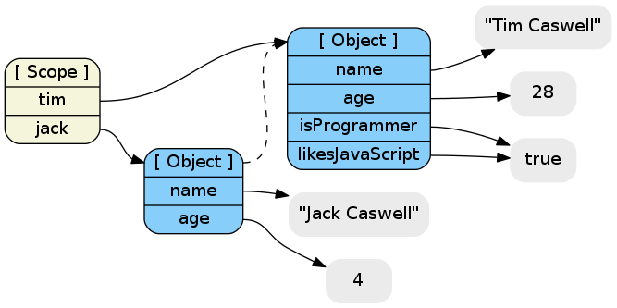
New object’s prototype is old one

Slide 34
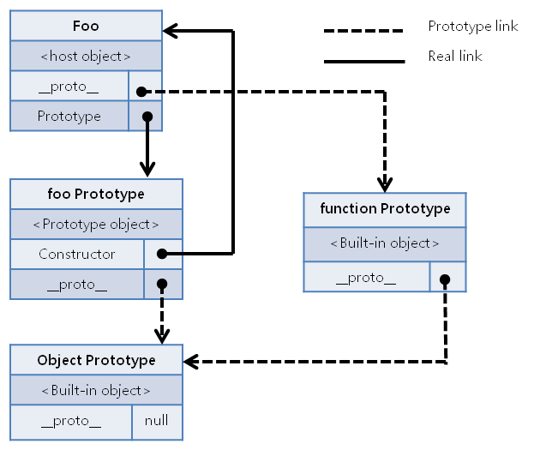
Prototype Chain

Slide 35
ES2015 Classes
Sugar for prototype based OO pattern
class Point {
constructor(x, y) {
this.x = x;
this.y = y;
}
toString() {
return '(' + this.x + ', ' + this.y + ')’; }
}
class ColorPoint extends Point {
constructor(x, y, color) {
super(x, y);
this.color = color;
}
toString() {
return super.toString() + ' in ' + this.color; }
}
}

Slide 36
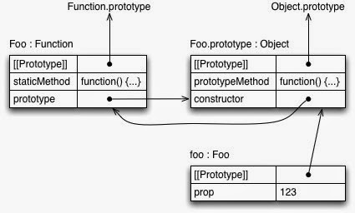
Method kinds
class Foo {
constructor(prop) { this.prop = prop; }
static staticMethod() { return 'classy’; }
prototypeMethod() { return 'prototypical‘; }
let foo = new Foo(123);

Slide 37
Array
is an object, with properties and methods added to the prototype (you can add your own)
  constructor
  length
  push()
  pop()
  reverse()
  join()
  …

Slide 38
Extending built-ins
Array.prototype.map = function (f) {
var result = [];
this.each (function (e) {
result.push(f(e));
});
return result;
}
> [1,2,3].map(function (x) {return x * x;});
[1, 4, 9]

Slide 39
flow control
if
switch
for
  for (var i=0; i<arrayname.length; i++) {}
  for (var itemkey in obj) {}
  for each (var itemvalue in obj) {}
while
do

Slide 40
eval
evaluates a string and returns a results
      var foo = 1;
      console.log( eval("foo + 1") );

