Slide 1
A new era: Topic-based Annotators

Slide 2
Classical approach
“Diego Maradona won against Mexico”
Dictionary of terms
against
Diego
Maradona
Mexico
won
Term Vector
Vector Space model
2.2
5.1
9.1
1.0
0.1
t₃
v
α
w
t₂
t₁
Similarity(v,w) ≈ cos(α)
Mainly term-based:
polysemy and synonymy issues

Slide 3
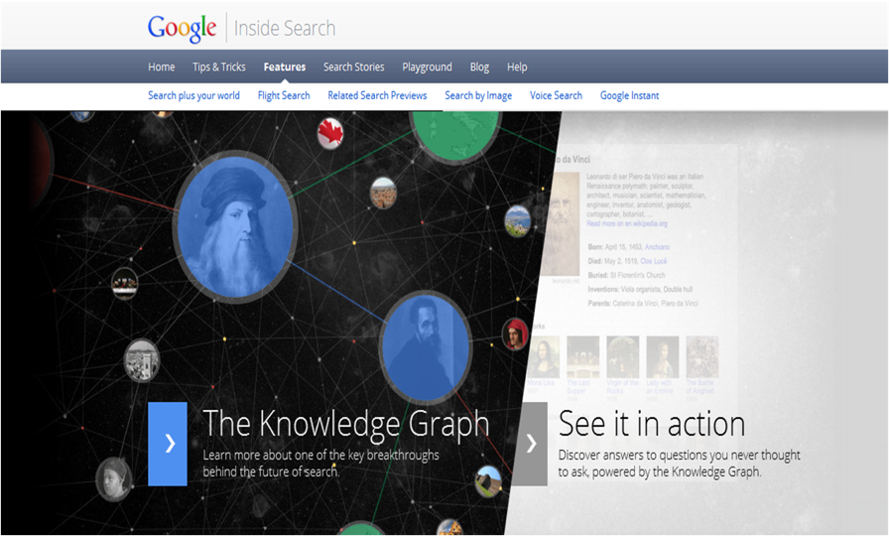
A new approach:
Massive graphs of entities and relations
May 2012
3

Slide 4
A typical issue: polysemy
the paparazzi photographed the star
the astronomer photographed the star

Slide 5
Another issue: synonymy
He is using Microsoft’s browser
He is a fan of Internet Explorer

Slide 6
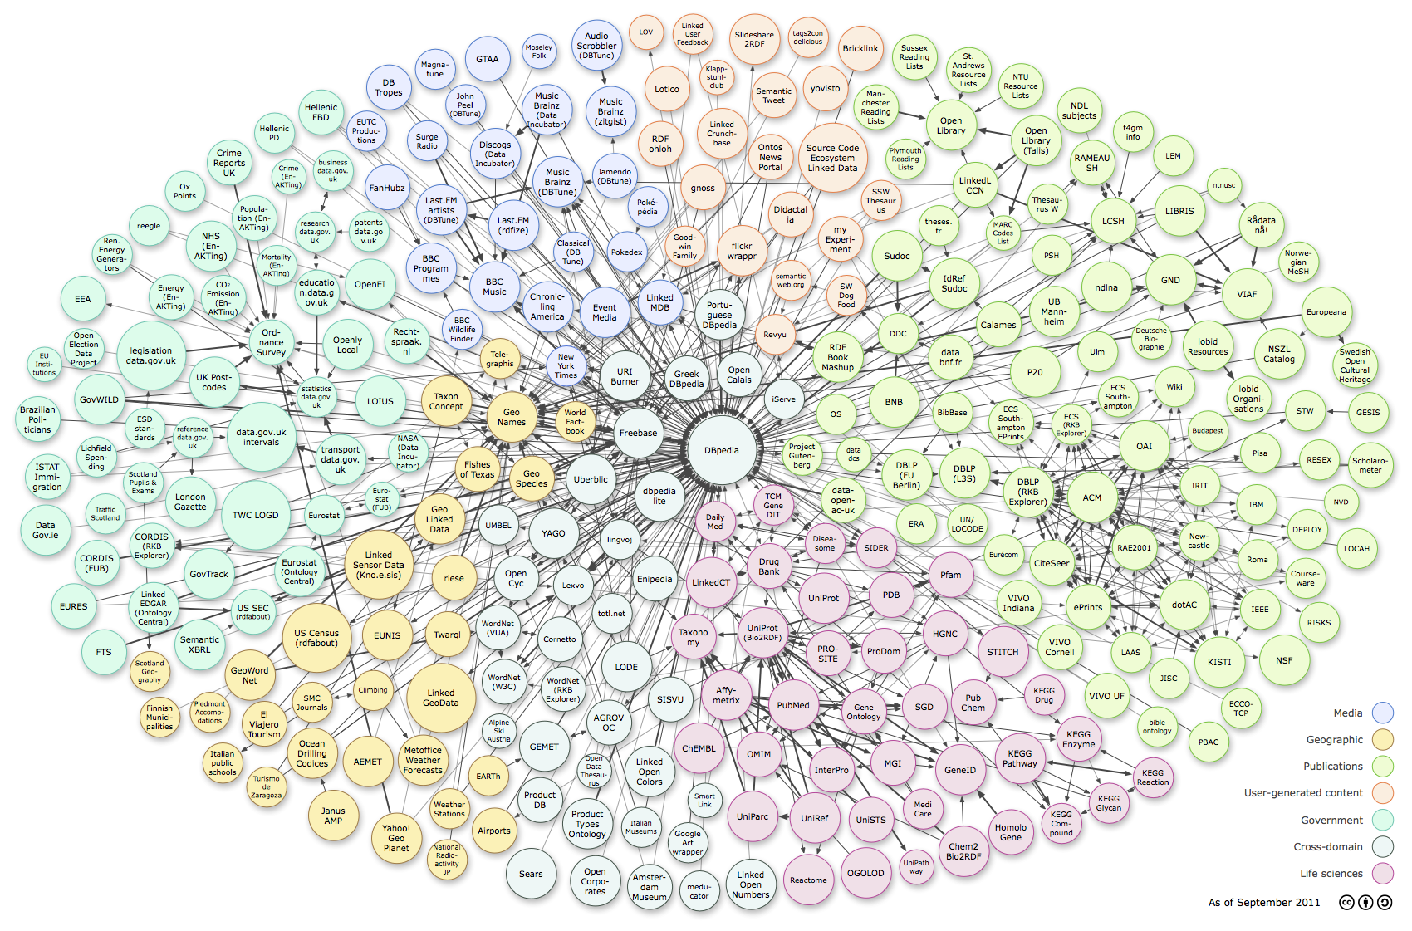
Web of Data: RDF, Tables, Microdata
Cyc
6
http://richard.cyganiak.de/2007/10/lod/lod-datasets_2011-09-19_colored.png
Thanks to G. Weikum, SIGMOD 2013

Slide 7
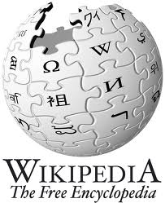
Web of Data: RDF, Tables, Microdata
4M entities in
250 classes
500M facts for
6000 properties
live updates
10M entities in
350K classes
120M facts for
100 relations
100 languages
95% accuracy
25M entities in
2000 topics
100M facts for
4000 properties
powers Google
knowledge graph
http://richard.cyganiak.de/2007/10/lod/lod-datasets_2011-09-19_colored.png
7
Thanks to G. Weikum, SIGMOD 2013

Slide 8
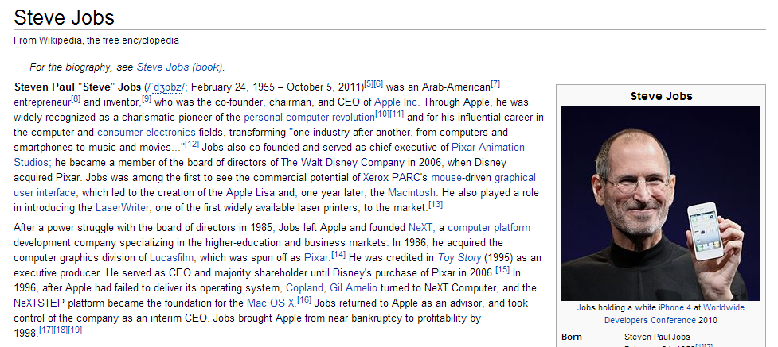
Wikipedia is a rich source of instances

Slide 9
Wikipedia's categories contain classes
Categories form a taxonomic DAG (not really…)

Slide 10
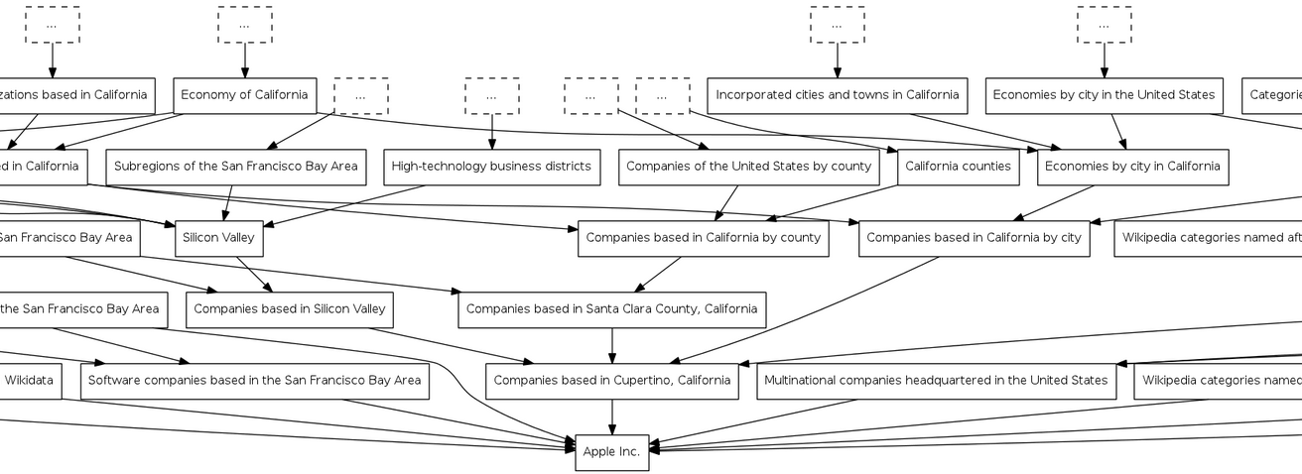
DAG of categories: http://toolserver.org/~dapete/catgraph/
10

Slide 11
A new approach: Topic-based annotation
“Diego Maradona won against Mexico”
Mexico’s football team
Ex-Argentina’s player
anchors
Find mentions and annotate them
with topics drawn from a catalog
articles
Wikipedia!

Slide 12
Polysemy
Celebrity is a person who is famou-sly recognized …
the paparazzi photographed the star
the astronomer photographed the star
Star is a massive, luminous ball of plasma …

Slide 13
Why is it a difficult problem?
“Diego Maradona won against Mexico”
Ex-Argentina’s coach
His nephew
Maradona Stadium
Maradona Movie
…
Mexico nation
Mexico state
Mexico football team
Mexico baseball team
…
Don’t annotate!

Slide 14
Features used by annotators
Commonness of a page p wrt an anchor a
Context of a around the mention and within a page/entity p
mention = …w₁ w₂ w₃ a w₄ w₅ w₆ …
page/entity p = …z₁ z₂ z₃ z₄ z₅ z₆ …
Link probability of an anchor a
Graph-based features
a is a mention-node
p is an entity-node
Links a ◻ p and paths between pages

Slide 15
The literature
Many commercial software: AlchemyAPI, DBpedia Spotlight, Extractiv, Lupedia, OpenCalais, Saplo, SemiTags, TextRazor, Wikimeta, Yahoo! Content Analysis, Zemanta.

Slide 16
[Ferragina-Scaiella, CIKM 2010]
tagme.di.unipi.it
Designed for short texts
news, blogs, search-results snippets, tweets, ads, etc
competitive on long texts too
Achieves high accuracy
Massive experimental test on millions of short texts
Fast
More than 10x faster than others
100% Java

Slide 17
How TAGME works
“Diego Maradona won against Mexico”
Diego A. Maradona
Diego Maradona jr.
Maradona Stadium
Maradona Film
…
…
Mexico nation
Mexico state
Mexico football team
Mexico baseball team
…
…
No Annotation
DISAMBIGUATION
by a voting scheme
PRUNING
2 simple features
PARSING

Slide 18
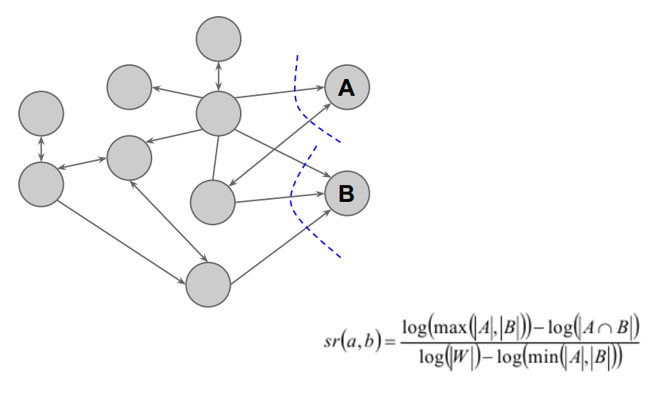
Relatedness between pages

Slide 19
Disambiguation: The voting scheme
Collective agreement among topics via voting
“Diego Maradona won against Mexico”
b
a
p_{b}
Diego A. Maradona
Diego Maradona jr.
Maradona Stadium
Maradona Film
…
Wiki-articles | Votes
Mexico | 0.09
State of Mexico | 0
Mexico National Football Team | 0.29
Mexico National Baseball Team | 0
p_{a}

Slide 20
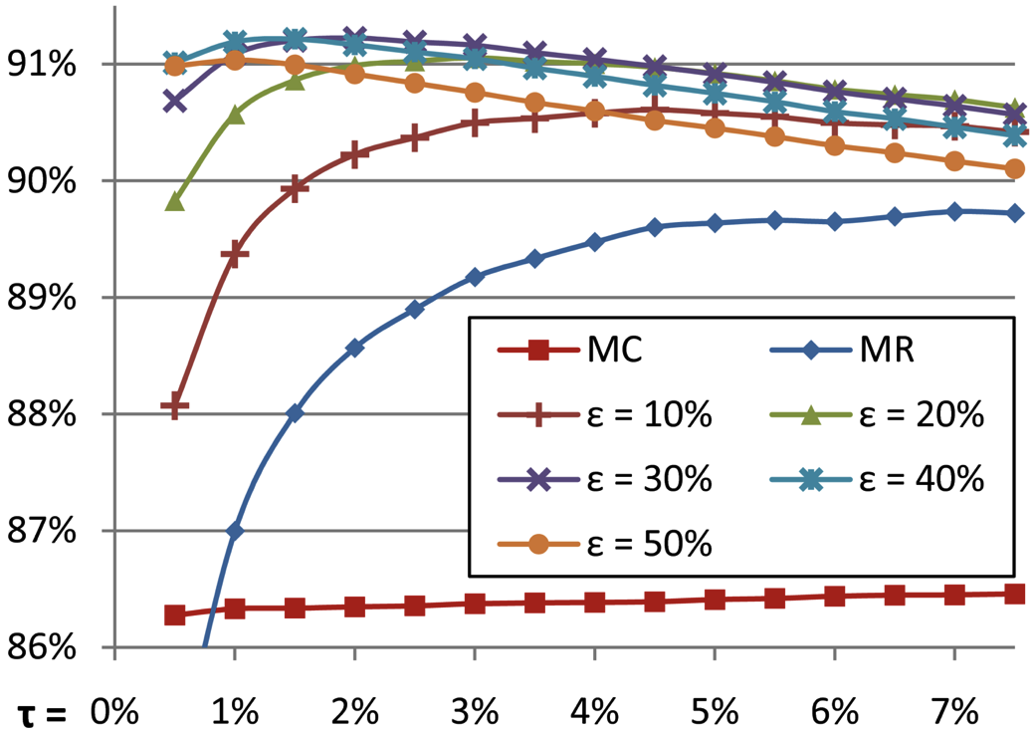
Disambiguation: all steps
τ = trade-off speed vs. recall
Commonness of a page p wrt an anchor a
Pruning by commonness < τ
Voting scheme
Select top-ε pages
Select the best in commonness

Slide 21
Pruning
We use 2 features:
link probability
coherence wrt context
Compute a ρ score via
3 classifiers, avg, linear combination
if ρ < ρ_{NA} then prune!
Link probability of an anchor a
Avg. relatedness btw the assigned concept to the others
balance
precision vs. recall

Slide 22
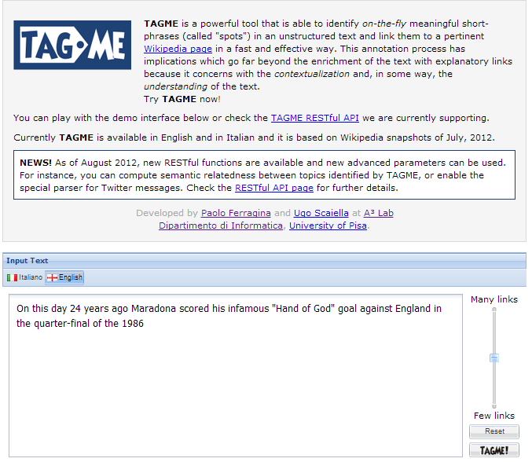

Slide 23
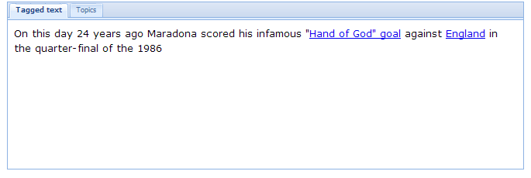
Less links
More links

Slide 24
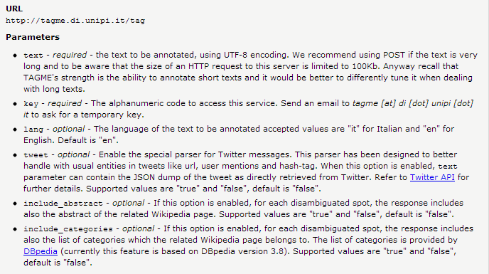
Tagging → Json

Slide 25
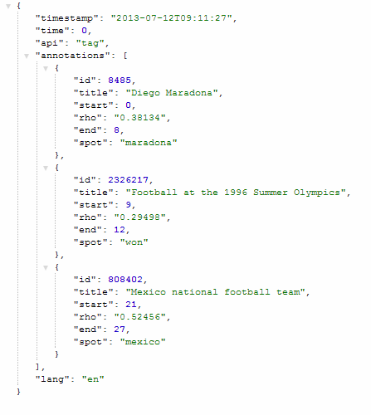
http://tagme.di.unipi.it/tag?text=maradona%20won%20against%20mexico&key=***
Useful for relating topics
NLP ?

Slide 26
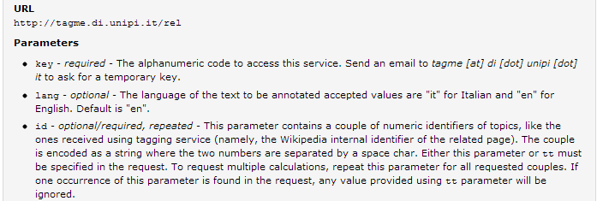
Relating topics
http://tagme.di.unipi.it/rel?id=8485%20615883&key=***
Maradona vs Totti
0,8157

Slide 27
We surpassed 200 Mln query

Slide 28
On comparing annotators

Slide 29
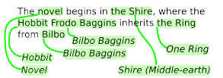
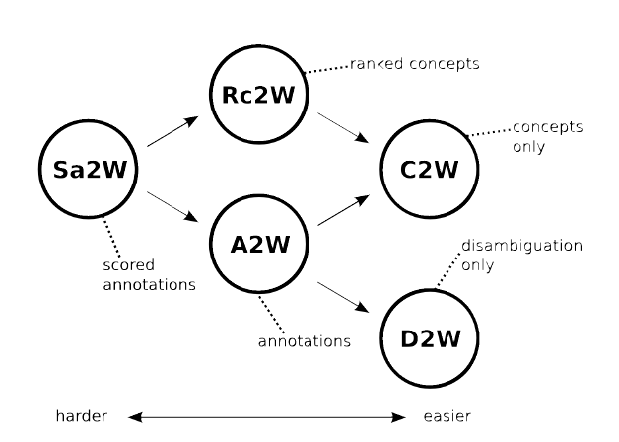
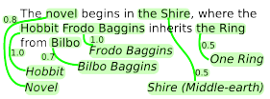
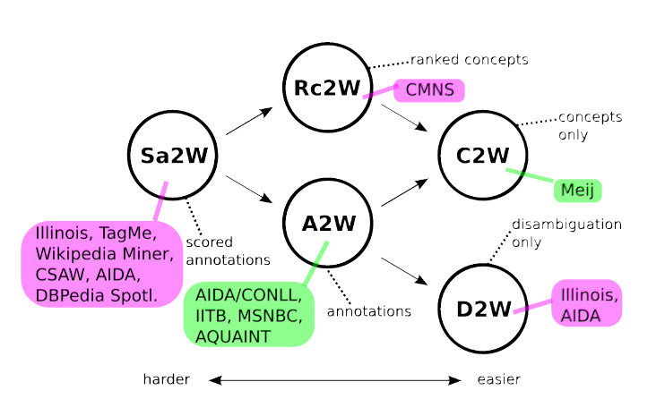
A word of caution !
A2W
Sa2W
Rc2W

Slide 33
Other approaches to topic-based annotation

Slide 34
Goal
Mentions = Anchor Texts
Entities = Wikipedia Pages
50
30
50
20
30
10
10
90
100
30
80
20
90
100
90
5
30
Main goal:
each mention is connected to at most one entity
34
Thanks to G. Weikum, SIGMOD 2013

Slide 35
Probability Factor Graph
Mentions = Anchor Texts
Entities = Wikipedia Pages
50
30
50
20
30
10
10
90
100
30
80
20
90
100
90
5
30
Collective Learning with Probabilistic Factor Graphs
[Chakrabarti et al.: KDD’09]
model P[m|e] by similarity and P[e1|e2] by coherence
consider likelihood of P[m1 … mk|e1 … ek]
factorize by all m-e pairs and e1-e2 pairs
use hill-climbing, LP etc. for solution
35
Thanks to G. Weikum, SIGMOD 2013

Slide 36
Dense Subgraph
Mentions = Anchor Texts
Entities = Wikipedia Pages
50
30
50
20
30
10
10
90
100
30
80
20
90
100
90
5
30
Compute dense subgraph such that:
each mention is connected to at most one entity
ML and classification (possibly based on unambiguous entities)
[Bunescu/Pasca 2006, Cucerzan 2007, Milne/Witten 2008, …]
36
Thanks to G. Weikum, SIGMOD 2013

Slide 37
Coherence Graph Algorithm
140
50
30
50
20
180
30
10
10
60
90
100
30
30
470
90
80
100
145
90
5
30
240
Compute dense subgraph such that:
each mention is connected to at most one entity
GOAL: maximize min weighted degree among entity nodes
Greedy approximation:
iteratively remove weakest entity and its edges
[Weikum et al. 2011]

Slide 38
Random Walks
ε
0.5
50
ε
0.83
0.3
50
30
0.2
20
0.23
ε
0.1
0.17
30
10
10
0.7
90
0.77
100
0.25
30
0.2
ε
0.4
20
0.75
80
90
0.75
0.96
90
100
ε
0.15
0.04
30
5
ε
for each mention run personalized PageRank with restart
rank entity e by stationary visiting probability, starting from m
38
Thanks to G. Weikum, SIGMOD 2013

Slide 39
Is it just a matter of “annotation” ?

Slide 40
BOW-representation
t₃
cos(α) = v • w / ||v|| * ||w||
d₂
α
d₁
d₅
t₁
t₂

Slide 41
New representation: #1
T = {w₁…w_{n}} be input text
<tfidf_{i}> be its TFIDF weight of word w_{i}
Wikipedia concept/entity c_{j}
Add concept/entity c_{j} to the vector representation of T with a weight that depends on the strength of pertinence of c_{j}

Slide 42
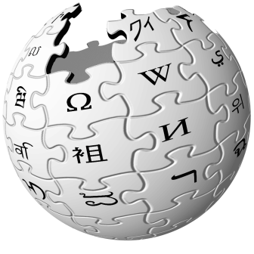
New representation: #2
obama says gaddafi may way out military assault
Barack Obama
Muammar
al-Gaddafi
Offensive
(military)
President of the United States
Libya
Ultimatum
us president issues libya ultimatum

Slide 43
Text as a sub-graph of topics
Barack Obama
President of the United States
Mahmoud Ahmadinejad
Iran
Ultimatum
RQ-170 drone
Graph analysis allows to find similarities between texts and entities even if they do not match syntactically (so at concept level)
Any relatedness measure over a graph, e.g. [Milne & Witten, 2008]

Slide 44
New representation: #3
Given two texts, we map them to two sets of nodes/entities
We stick onto the graph representation
Graph-KB of concepts
Text 1
Volumes
of random paths
Text 2

