Slide 1

Deep Learning for NL
Giuseppe Attardi
Dipartimento di Informatica
Università di Pisa

Slide 2
Statistical Machine Learning
Training on large document collections
Requires ability to process Big Data
  If we used same algorithms 10 years ago they would still be running
The Unreasonable Effectiveness of Big Data

Slide 3
Supervised Statistical ML Methods
Devise a set of features to represent data:
  φ(x) ∈ R^{D} and weights w_{k} ∈ R^{D}
Objective function
  f(x) = argmax_{k} w_{k} φ(x)
Minimize error wrt training examples
Freed us from devising rules or algorithms
Required creation of annotated training corpora
Imposed the tyranny of feature engineering

Slide 4
Deep Neural Network Model
Output layer
Prediction of target
Hidden layers
Learn more abstract representations
Input layer
Raw input
…
…
…
…

Slide 5
Deep Learning Breakthrough: 2006
Unsupervised learning of shallow features from large amounts of unannotated data
Features are tuned to specific tasks with second stage of supervised learning

Slide 6
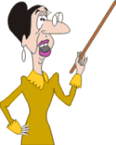
Supervised Fine Tuning
Should be: 2
Output: f(x)
Courtesy: G. Hinton

Slide 7
Application Areas
Typically applied to image and speech recognition, and NLP
Each are non-linear classification problems where the inputs are highly hierarchal in nature (language, images, etc)
The world has a hierarchical structure – Jeff Hawkins – On Intelligence
Problems that humans excel in and machine do very poorly

Slide 8
Deep vs Shallow Networks
Given the same number of non-linear (neural network) units, a deep architecture is more expressive than a shallow one (Bishop 1995)
Two layer (plus input layer) neural networks have been shown to be able to approximate any function
However, functions compactly represented in k layers may require exponential size when expressed in 2 layers

Slide 9
Deep Network
Shallow Network
Shallow (2 layer) networks need a lot more hidden layer nodes to compensate for lack of expressivity
In a deep network, high levels can express combinations between features learned at lower levels
Notes:
Analogy – nodes as features

Slide 10
Traditional Supervised Machine Learning Approach
For each new problem:
  Gather as much LABELED data as you can get \ handle
  Throw a bunch of algorithms at it (after trying RF \ SVM ... insert favorite algo here)
  Pick the best
  Spend hours hand engineering some features \ doing feature selection \ dimensionality reduction (PCA, SVD, etc)
  RINSE AND REPEAT…..

Slide 11
Biological Justification
This is NOT how humans learn
Humans learn facts and skills and apply them to different problem areas
  -> Transfer Learning
Humans first learn simple concepts, and then learne more complex ideas by combining simpler concepts
There is evidence that the cortex has a single learning algorithm:
  Inputs from optic nerves of ferrets was rerouted to into their audio cortex
  They were able to learn to see with their audio cortex instead
If we want a general learning algorithm, it needs to be able to:
  Work with any type of data
  Extract it’s own features
  Transfer what it’s learned to new domains
  Perform multi-modal learning – simultaneously learn from multiple different inputs (vision, language, etc)

Slide 12
Unsupervised Training
Far more un-labeled data in the world (i.e. online) than labeled data:
  Websites
  Books
  Videos
  Pictures
Deep networks take advantage of unlabelled data by learning good representations of the data through unsupervised learning
Humans learn initially from unlabelled examples
Babies learn to talk without labeled data

Slide 13
Unsupervised Feature Learning
Learning features that represent the data allows them to be used to train a supervised classifier
As the features are learned in an unsupervised way from a different and larger dataset, less risk of over-fitting
No need for manual feature engineering
  (e.g. Kaggle Salary Prediction contest)
Latent features are learned that attempt to explain the data

Slide 14
Unsupervised Learning - Distributed Representations
Approaches to unsupervised learning of features fall into two categories:
  Local Representations (hard clustering)
  Distributed Representations (soft \ fuzzy clustering)
Hard clustering approaches (e.g. k-means, DBSCAN) - learn to map a set of data points to individual clusters

Slide 15
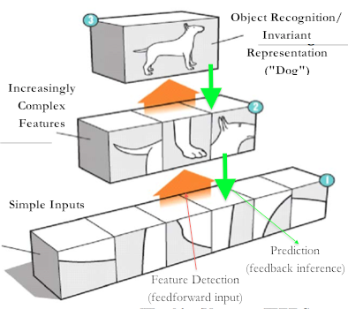
Hierarchical Representations

Slide 16

Deep Neural Network
object models
object parts
(combination
of edges)
Training set:
aligned images of faces
edges
pixels
slide from Honglak Lee

Slide 17
Discriminative vs Generative Models
2 types of classification algorithms
Generative – Model Joint Distribution
  p(Class ∧ Data)
  E.g. Naïve Bayes, HMM, RBM, LDA
Discriminative – Conditional Distribution
  p(Class|Data)
  E.g. Decision Trees, SVMs, Nnets, Linear Regression, Logistic Regression

Slide 18
Discriminative Vs Generative Models
Discriminative models tend to give better classification accuracy
BUT are more prone to over-fitting
Generative models can be used to generate conditional models:
  p(A|B) = p(A ∧ B)/p(B)
Generative models can also generate samples of data according to the distribution of the training data (hence the name) i.e. they learn to model the data distribution not Class\Data

Slide 19
Discriminative + Generative Model
–> Semi-Supervised Learning
In deep learning, a generative model (RBM, Auto-Encoder) is learned from the data
Generative model maximizes prior: p(Data)
Then a discriminative classifier is trained using the features learned from the generative model
This maximizes posterior: p(Class|Data)
Popular discriminative classifiers used:
  NNet soft max layer
  SVM
  Logistic Regression

Slide 20
Neural Networks – Very Brief Primer
Activation Function
Back Propagation
Gradient Descent
slides by Simon
Notes:
Ask if I need to cover this

Slide 21
Layered Network
Input nodes
Output nodes
Hidden nodes
Connections
slide from G. Hinton

Slide 22
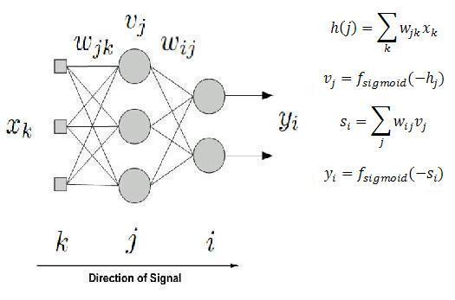
Network Layer

Slide 23
Activation Function
For each neuron, sum the inputs multiplied by their weights, and add the bias
The result is passed through an activation function, whose output feeds the next layer
Non-linearity needed to learn non-linear functions
Typical functions:
  sigmoid function (as in logistic regression)
  Hyperbolic tangent (has a shallower gradient around the limits)

Slide 24
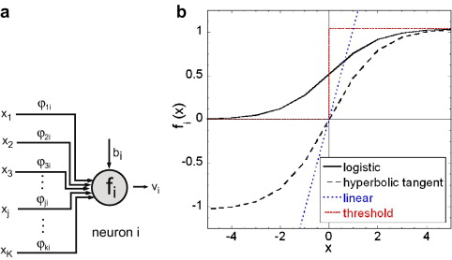
Activation Functions

Slide 25
Back Propagation 101
Learn: y = f(x)
For each Neuron:
  Activation <- Sum the inputs, add the bias, apply the activation function
Activations propagate through the layers
Output Layer: compute error for each neuron:
  Error = y – f(x)
Update the weights using the derivative of the error
Backwards – propagate the error derivatives through the hidden layers

Slide 26
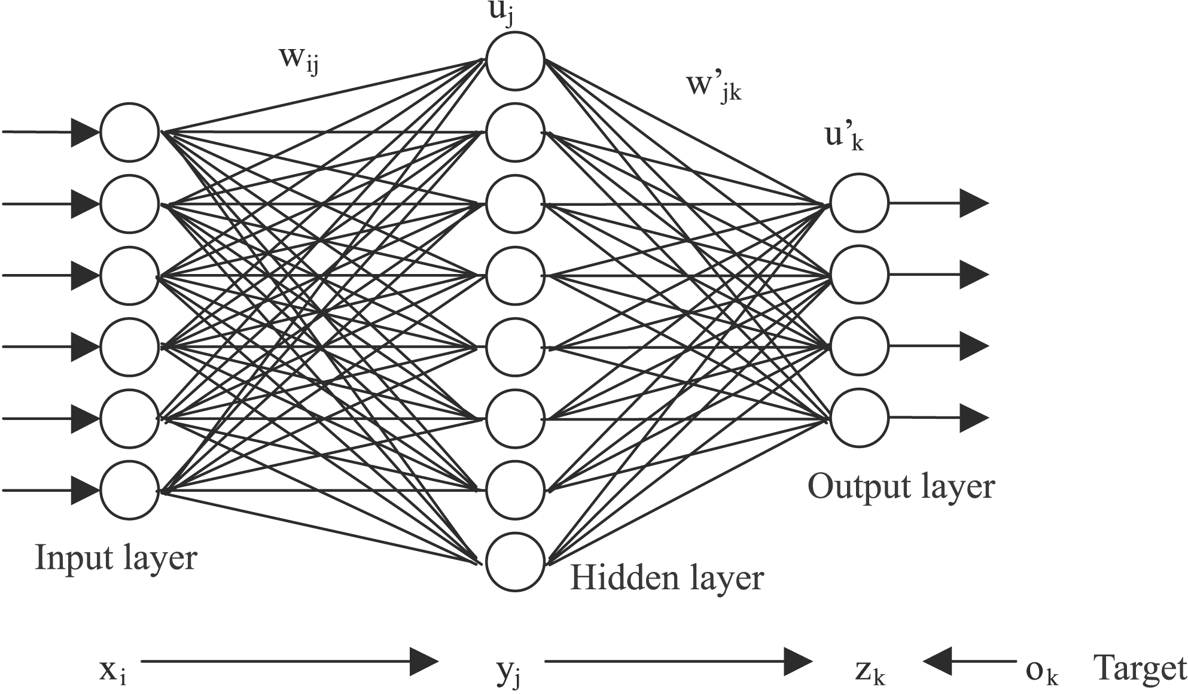
Backpropagation
Errors
Notes:
Typical FF Nnet – back propagation sends weight updates from the output layer back through to the hidden layer(s)

Slide 27
Gradient Descent
  Weights are updated using the partial derivative of the activation function w.r.t. the error
  Derivative pushes learning down the gradient of steepest descent on the error curve

Slide 28
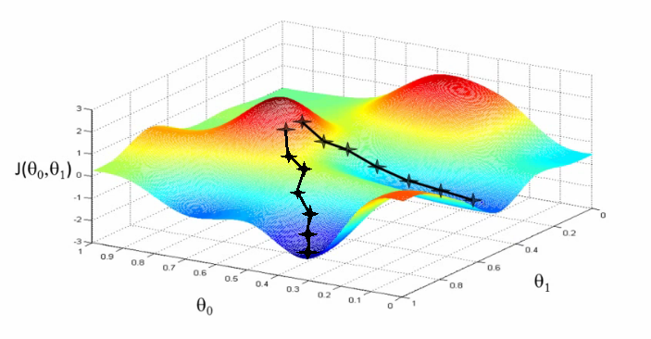
Gradient Descent

Slide 29
Drawbacks - Backpropagation
Needs labeled data (most data is not labeled)
Scalability – does not scale well over multiple layers
  Very slow to converge
  “Vanishing gradients problem”: errors shrink exponentially with the number of layers
  Thus makes poor use of many layers
  This is the reason most feed forward neural networks have only 3 layers
More info: “Understanding the Difficulty of Training Deep Feed Forward Neural Networks”

Slide 30
Brief History of Deep Learning
See: http://www.ipam.ucla.edu/publications/gss2012/gss2012_10596.pdf
1960’s – Perceptron invented (single neuron)
1960’s – Papert and Minsky prove that perceptrons can only learn to model linearly separable functions. Interest in perceptrons rapidly declines.
1970’s-1980’s – Back propagation (BP) invented for training multiple layers of non-linear features. Leads to a resurgence in interest in neural networks
  BP takes errors from the output layer and propagates them back through the hidden layer(s)
1990’s - Many researchers gave up on BP as it could not make effective use of multiple hidden layers
1990’s – present: Simple, faster models, such as SVM’s came to dominate the field

Slide 31
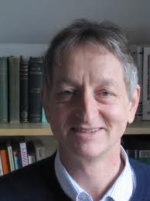
Brief History of Deep Learning
Mid 2000’s – Geoffrey Hinton makes a breakthrough, trains deep belief networks by
  Stacking RBM’s on top of one another – deep belief network
  Training layer by layer on un-labeled data
  Using back prop to fine tune weights on labeled data
Bengio et al, 2006 – examined deep auto-encoders as an alternative to Deep Boltzmann Machines
  Easier to train

Slide 32
Enabling Factors
Training of deep networks was made computationally feasible by:
  Faster CPU’s
  The move to parallel CPU architectures
  Advent of GPU computing
Neural networks are often represented as a matrix of weight vectors
GPU’s are optimized for very fast matrix multiplication
2008 - Nvidia’s CUDA library for GPU computing is released

Slide 33
Implementation
Most current architectures consist of learning layers of RBM’s or Auto-Encoders
Both are 2 layer neural networks that learn to model their inputs
Key difference:
  RBM’s model their inputs as a probability distribution
  Auto-Encoders learn to reproduce inputs as their outputs

Slide 34
Restricted Boltzmann Machines (RBM’s)
Two layer undirected (bi-directional) neural network:
  Visible Layer
  Hidden Layer
Connections run visible to hidden
No connections within each layer
Trained to maximize the expected log probability of the data
For the physicists\chemists: ‘Boltzmann’ as they minimize the energy of the data (equates to maximizing the probability)
Inputs are binary vectors (as it learns Bernouli distributions over each input)

Slide 35
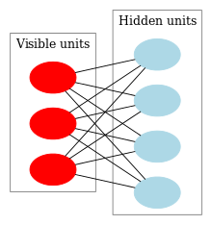
RBM Structure – Bipartite Graph

Slide 36
Activation Function
The activation function is computed the same way as in a regular neural network
Logistic function usually used (0-1)
However, the output is treated as a probability and each neuron is activated if activation > random variable(0-1)
Hidden layer neurons take visible units as inputs
Visible neurons take binary input vectors as initial input, then hidden layer probabilities (during Gibbs sampling – next slide)

Slide 37
Training Procedure
Stochastic Gradient Descent
Remarkably simple
Can be parallelized
  Asynchronous Stochastic Gradient Descent

Slide 38
Contrastive Divergence
PASS 1: From inputs v, compute hidden layer probabilities h
PASS 2: Pass those values back down to the visible layer, and back up to the hidden layer to get v’ and h’
Update the weights using the differences in the inner products of the hidden and visible activations between the first and second passes (multiplied by some learning rate)

Slide 39
Feature Representation
Once trained, the hidden layer activations of an RBM can be used as learned features

Slide 40
Deep Learning for NLP

Slide 41
Word Vectors
To do NLP with neural networks, words need to be represented as vectors
Traditional approach – “one hot vector”
  Binary vector
  Length = | vocab |
  1 in the position of the word id, the rest are 0
However, does not represent word meaning
Similar words such as “English” and “French”, “cat” and “dog” should have similar vector representations
However, similarity between all “one hot vectors” is the same

Slide 42
Solution: Distributional Word Vectors
Word is represented as a distribution over k latent variables
Distribution chosen so that similar words have similar distributions
Traditional approaches have used various vector space models
  Words form the rows
  Columns represent the context (other words occurring within x words, whole documents, etc)
  Cells represent co-occurrence (binary vectors) frequency, tf-idf or relative distance from the context word
  Dimensionality reduction (PCA, SVD, etc) used to reduce the vector size

Slide 43
Neural Word Embeddings
Various researchers (Bengio, Collobert and Weston, Hinton) have used neural language models to develop “word embeddings”
A language model is a statistical model that assigns a probability to words given the preceding words
Have similar properties to distributional word vectors, but claim better representations

Slide 44
Neural Word Embeddings
Collobert and Weston, 2008 -“A Unified Architecture for Natural Language Processing”
They extracted all 11-length n-grams from the entire of Wikipedia
Middle (6th) word is the target word
Negative examples are created by replacing the middle word with a different word chosen randomly
For each word, they randomly initialized a 50 element vector
The n-grams are then translated into input vectors by concatenating the corresponding vector for each word
These are fed into a neural network that is trained to maximize the difference between the probability it assigns to a valid versus an invalid sentence
Errors are propagated back into the word embeddings

Slide 45
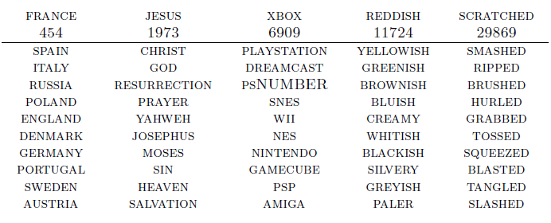
Results
Example words with their 10 nearest neighbors according to the embeddings:
Notes:
From “A Unified Architecture for Natural Language Processing: Deep Neural Networks with Multitask Learning” – Collobert and Weston, 2008, p6

Slide 46
A Unified Architecture for NLP
Using a very complex, deep architecture, Collobert and Weston were able to train a single deep model to do:
  NER (Named Entity Recognition)
  POS tagging
  Chunking (shallow parsing)
  Parsing
  SRL (Semantic Role Labeling)
Model is too complex to cover here
No hand engineered features were used
Achieved either near SOTA or the SOTA in each of the above domains

Slide 47
Useful Deep Learning Links
Deeplearning.Net:
  Code, tutorials, papers
  http://deeplearning.net/
Theano (Cuda + Python also):
  Comprehensive tutorials
  Symbolic programming (like SymPy) can be a little confusing
  http://deeplearning.net/software/theano/
Toronto groups’ code (Cuda + Python):
  Easier to understand than Theano
  https://github.com/nitishsrivastava/deepnet
www.socher.org
  All of Richard Socher’s research papers and code
  Links to his tutorials on YouTube on Deep Learning and NLP

Slide 48
SENNA
The SENNA system developed by Collobert and Weston
  http://ronan.collobert.com/senna/
  A pretty complete NLP system (for download) that uses Deep Learning to perform NER, POS tagging, parsing, chunking and SRL
  Contains the word embeddings file so you can use their word embeddings in your own work
DeepNL, by Attardi
  https://github.com/attardi/deepnl
  All methods of SENNA (including training)
  Sentiment/Discriminative Word Embedding
  Convolutional Neural Networ

Slide 49
Vector Representation of Words
From discrete to distributed representation
Word meanings are dense vectors of weights in a high dimensional space
Algebraic properties
Background
  Philosophy: Hume, Wittgenstein
  Linguistics: Firth, Harris
  Statistics ML: Feature vectors
”You shall know a word by the company it keeps”
(Firth, 1957).

Slide 50
Distributional Semantics
Co-occurrence counts
High dimensional sparse vectors
Similarity in meaning as vector similarity
 | shining | bright | trees | dark | look
stars | 38 | 45 | 2 | 27 | 12
tree
stars
sun

Slide 51
Co-occurrence Vectors
FRANCE 454 | JESUS 1973 | XBOX 6909 | REDDISH 11724 | SCRATCHED 29869 | MEGABITS 87025
PERSUADE | THICKETS | DECADENT | WIDESCREEN | ODD | PPA
FAW | SAVARY | DIVO | ANTICA | ANCHIETA | UDDIN
BLACKSTOCK | SYMPATHETIC | VERUS | SHABBY | EMIGRATION | BIOLOGICALLY
GIORGI | JFK | OXIDE | AWE | MARKING | KAYAK
SHAFFEED | KHWARAZM | URBINA | THUD | HEUER | MCLARENS
RUMELLA | STATIONERY | EPOS | OCCUPANT | SAMBHAJI | GLADWIN
PLANUM | GSNUMBER | EGLINTON | REVISED | WORSHIPPERS | CENTRALLY
GOA’ULD | OPERATOR | EDGING | LEAVENED | RITSUKO | INDONESIA
COLLATION | OPERATOR | FRG | PANDIONIDAE | LIFELESS | MONEO
BACHA | W.J. | NAMSOS | SHIRT | MAHAN | NILGRIS
neighboring words are not semantically related

Slide 52
Techniques for Creating Word Embeddings
Collobert et al.
  SENNA
  Polyglot
  DeepNL
Mikolov et al.
  word2vec
Lebret & Collobert
  DeepNL
Socher & Manning
  GloVe

Slide 53
Neural Network Language Model
LM likelihood
Expensive to train:
  3-4 weeks on Wikipedia
U
Word vector
the cat sits on
… cat …
LM prediction
Quick to train:
  40 min.on Wikipedia
  tricks:
    parallelism
    avoid synchronization
U
Σ
the sits on

Slide 54
Lots of Unlabeled Data
Language Model
  Corpus: 2 B words
  Dictionary: 130,000 most frequent words
  4 weeks of training
Parallel + CUDA algorithm
  40 minutes

Slide 55
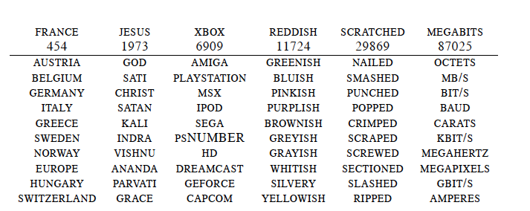
Word Embeddings
neighboring words are semantically related

Slide 56
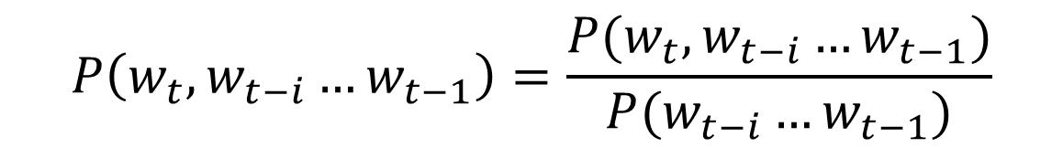
Back to Co-occurrence Counts
$$P\left(w_{t}, w_{t−i}…w_{t−1}\right)=\frac{P(w_{t}, w_{t−i}…w_{t−1})}{P(w_{t−i}…w_{t−1})}$$
 | breeds | computing | cover | food | is | meat | named | as
cat | 0.04 | 0.0 | 0.0 | 0.13 | 0.53 | 0.02 | 0.16 | 0.1
dog | 0.11 | 0.0 | 0.0 | 0.12 | 0.39 | 0.06 | 0.18 | 0.17
cloud | 0/0 | 0.29 | 0.19 | 0.0 | 0.12 | 0.0 | 0.0 | 0.4
Big matrix |V| × |V| (~ 100k × 100k)
Dimensionality reduction:
  Principal Component Analysis, Hellinger PCA, SVD
Reduce to:100k × 50, 100k × 100

Slide 57
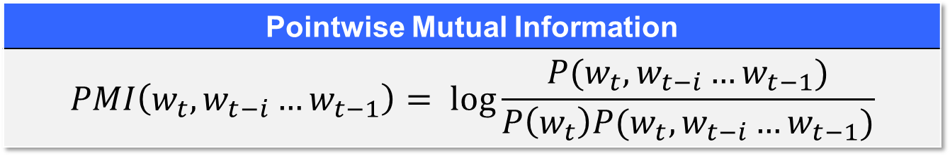
Weighting
Weight the counts using corpus-level statistics to reflect
co-occurrence significance
Pointwise Mutual Information

Slide 58
Online Demos
Polyglot
Attardi
Lebret

Slide 59
Applications
NER
IMDB Movie Reviews
Approach | F1
Ando et al. 2005 | 89.31
Word2Vec | 88.20
GloVe | 88.30
SENNA | 89.51
Model | Accuracy
Wang & Manning | 91.2
Brychcin & Habernal | 92.2
H-PCA | 89.9

Slide 60
Visualizing Embeddings
t-SNE: tool for visualization of high-dimensional dataset

Slide 61
Deep Learning for NLP

Slide 62
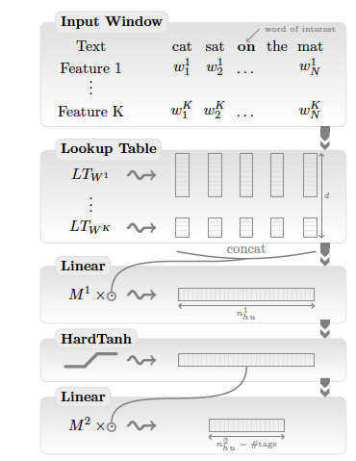
A Unified Deep Learning Architecture for NLP
NER (Named Entity Recognition)
POS tagging
Chunking
Parsing
SRL (Semantic Role Labeling)
Sentiment Analysis

Slide 63
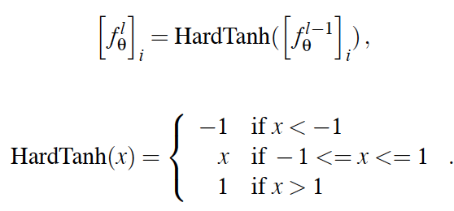
HardTanh Layer
Window approach
Non-linear feature
representation

Slide 64
Window Approach Limits
It does not work well in the SLR task
because the tag of a word depends on a verb which might fall outside the window

Slide 65
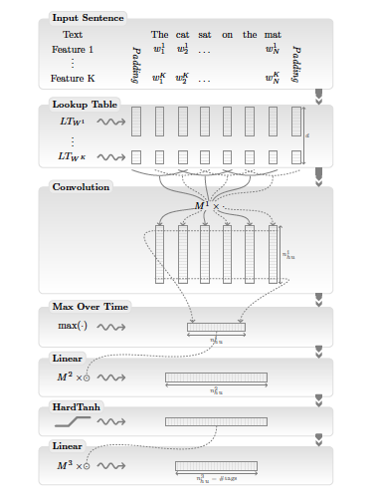

Convolutional Layer
Sentence approach
sentence the entire input vector
→ in one input, input by shifting the time to every word

Slide 66

Training
Maximize log-likelihood

Slide 67
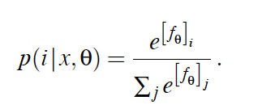


Training
Word Level Log-Likelihood
soft max all
over tags

Slide 68
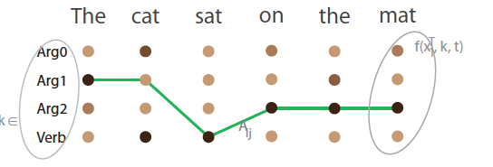

Training
Sentence Level Log-Likelihood
transition score to jump from tag k to tag i
Sentence score for a tag path

Slide 69

Training
Sentence Level Log-Likelihood
Conditional likelihood
by normalizing w.r.t all possible paths

Slide 70
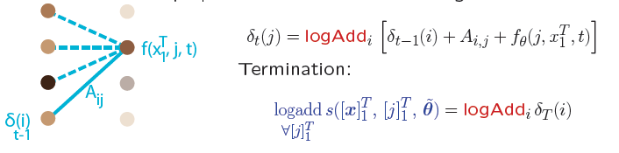
Training
Regularization can be calculated by the recursive forward algorithm
Inference: Viterbi algorithm (replace logAdd by max)

Slide 71
Creating the Embeddings

Slide 72
Obtain Text Corpora
Wikipedia
  Get XML dumps from:
    http://download.wikimedia.org/
  Get WikiExtractor from:
    http://medialab.di.unipi.it/wiki/Wikipedia_Extractor
  Extract the text:
    WikiExtractor.py -o text itwiki-latest-pages-articles.xml.bz2

Slide 73
Sentence splitting and tokenization
NLTK
  Punkt sentence splitter
    import nltk.data
    splitter = nltk.data.load('tokenizers/punkt/english.pickle')
    for line in file:
      for sent in splitter.tokenize(line.strip()):
      print sent
  Tokenizer
    tokenizer = splitter._lang_vars. word_tokenize
    print ' '.join(tokenizer(sent))
Normalize (optional)
  Convert to lowercase
  Replace digits with '0'

Slide 74
Create Embeddings
word2vec
  Download and compile:
    > svn checkout http://word2vec.googlecode.com/svn/trunk/ word2vec
    > cd word2vec
    > make
  Run
    > word2vec word2vec -train train.txt -output vectors.txt
    -cbow 1 -size 50 -window 5 -min-count 40 -negative 0
    -hs 1 -sample 1e-3 -threads 24 -debug 0

Slide 75
Sequence Taggers

Slide 76
Train POS Tagger
Input: tab separated token/tag, one per line
  Mr. NNP
  Vinken NNP
  is VBZ
  chairman NN
  of IN
  Elsevier NNP
> dl-pos.py pos.dnn -t wsj.pos
--vocab vocab.txt --vectors vectors.txt
--caps --suffixes suffix.list -w 5 -n 300 –e 10

Slide 77
Test POS Tagger
> dl-pos.py pos.dnn < input.tokens

Slide 78
Train NER Tagger
Input in Conll03 tab separated format:
  EU NNP I-NP I-ORG
  rejects VBZ I-VP O
  German JJ I-NP I-MISC
  call NN I-NP O
  to TO I-VP O
  boycott VB I-VP O
  British JJ I-NP I-MISC
  lamb NN I-NP O
> dl-ner.py ner.dnn -t wsj.conll03
--vocab vocab.txt --vectors vectors.txt
--caps --suffixes suffix.list -w 5 -n 300
–e 10 --gazetteer entities.list

Slide 79
Perform NER Tagging
> dl-ner.py ner.dnn < input.file

Slide 80
Train Dependency Parser
Configuration file:
  Features FORM -1 0 1
  Features LEMMA -1 0 1 prev(0) leftChild(0) rightChild(0)
  Features POSTAG -2 -1 0 1 2 3 prev(0) leftChild(-1) leftChild(0)
  Features CPOSTAG -1 0 1 rightChild(0) rightChild(rightChild(0))
  Features FEATS -1 0 1
  Features DEPREL leftChild(-1) leftChild(0) rightChild(-1)
  Feature CPOSTAG(-1) CPOSTAG(0)
  Feature CPOSTAG(0) CPOSTAG(1)
  if(POSTAG(0) = "IN", LEMMA(0)) LEMMA(last(POSTAG, "V"))
> desr -c conf -t -m model train.corpus
Linguistic feature: use lemma of last verb if current word is preposition

Slide 81
Perform Dependency Parsing
> desr -m model < input.conll

Slide 82
Evaluate Dependency Parser
> eval09.py –g gold.file –s system.file

Slide 83

Parser Online Demo

Slide 84
Annotating, Visualizing Dependencies
DgaAnnotator
Brat Rapid Annotation Tool

Slide 85
Code Base
DeepNL
https://github.com/attardi/deepnl
DeSR parser
https://sites.google.com/site/desrparser/

Slide 86
Disadvantages of Deep Learning
Steep learning curve
Some problems more amenable to deep learning than other applications
Simpler models may be sufficient for certain problem domains
Regression models?
Unless you are working with images, the models are very hard to explain (compared with a decision tree)
  What does neuron 524 do?

Slide 87
Limits of Word Embeddings
Limited to words (neither MW nor phrases)
Represent similarity: antinomies often appear similar
  Not good for sentiment analysis
  Not good for polysemous words
Solution
  Semantic composition
  or …

Slide 88
Recursive Neural Networks
Tina likes tigers
likes tigers
Tina
likes
tigers

Slide 89
Sense Specific Word Embeddings
Sentiment Specific Word Embeddings
Uses an annotated corpus with polarities (e.g. tweets)
SS Word Embeddings achieve SOTA accuracy on tweet sentiment classification
LM likelihood + Polarity
U
the cat sits on

Slide 90
Context Aware Word Embeddings
LM likelihood
U
W
Σ
the cat sits on
Applications:
  Word sense disambiguation
  Document Classification
  Polarity detection
  Adwords matching

Slide 91
More NLP tasks

Slide 92
Machine Translation
K. Cho, B. van Merrienboer, C. Gulcehre, F. Bougares, H. Schwenk, Y. Bengio. Learning phrase representations using RNN encoder-decoder for statistical machine translation. arXiv preprint arXiv:1406.1078, 2014.

Slide 93
Question Answering
B. Peng, Z. Lu, H. Li, K.F. WongToward Neural Network-based Reasoning
A. Kumar et al.Ask Me Anything: Dynamic Memory Networks for Natural Language Processing
H. Y. Gao et al. Are You Talking to a Machine? Dataset and Methods for Multilingual Image Question Answering, NIPS, 2015.

Slide 94
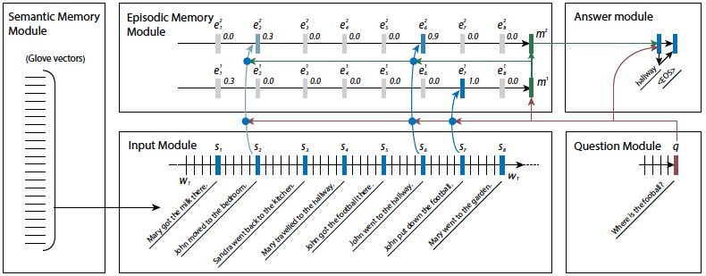
Ask Me Anything

Slide 95
Text Understanding from Scratch
  Zhang, X., & LeCun, Y. (2015). Text Understanding from Scratch.
  http://arxiv.org/abs/1502.01710

Slide 96
Video
Deep Learning Applications
  R. Socher, Stanford
  https://www.youtube.com/watch?v=BVbQRrrsJo0

Slide 97
Quiz Bowl Competition
Iyyer et al. 2014: A Neural Network for Factoid Question Answering over Paragraphs
QUESTION:
  He left unfinished a novel whose title character forges his father’s signature to get out of school and avoids the draft by feigning desire to join. A more famous work by this author tells of the rise and fall of the composer Adrian Leverkühn. Another of his novels features the jesuit Naptha and his opponent Settembrini, while his most famous work depicts the aging writer Gustav von Aschenbach. Name this German author of The Magic Mountain and Death in Venice.

Slide 98
Bowl Competition
QANTA vs Ken Jennings
  https://www.youtube.com/watch?v=kTXJCEvCDYk

Slide 99
References
R. Collobert et al. 2011. Natural Language Processing (Almost) from Scratch. Journal of Machine Learning Research, 12, 2461–2505.
Q. Le and T. Mikolov. 2014. Distributed Representations of Sentences and Documents. In Proc. of the 31st International Conference on Machine Learning, Beijing, China, 2014. JMLR:W&CP volume 32.
Rémi Lebret and Ronan Collobert. 2013. Word Embeddings through Hellinger PCA. Proc. of EACL 2013.
O. Levy and Y. Goldberg. 2014. Neural Word Embeddings as Implicit Matrix Factorization. In Advances in Neural Information Processing Systems (NIPS).
T. Mikolov, K. Chen, G. Corrado, and J. Dean. 2013. Efficient Estimation of Word Representations in Vector Space. In Proceedings of Workshop at ICLR, 2013.
Tang et al. 2014. Learning Sentiment-Specific Word Embedding for Twitter Sentiment Classification. In Proc. of the 52nd Annual Meeting of the ACL, 1555–1565,

