Slide 1


Automatic Speech Recognition (ASR)
HISTORY, ARCHITECTURE, COMMON APPLICATIONS AND THE MARKETPLACE
Omar Khalil Gómez – Università di Pisa

Slide 2
What is ASR?
Spoken language understanding is a difficult task
  I will become a pirate” vs “I will become a pilot”
ASR “addresses” this task computationally
  From an acoustic signal to a string of words -> mapping
Automatic speech understanding (ASU) is the goal
  Understand the sentence rather than know just the words
Another related fields
  Speech synthesis, text-to-speech

Slide 3
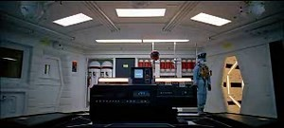
ASR then and… tomorrow¿?
Origin
future
Why should i need ASR?
  First electric implements (1800)
Can we emulate the human behaviour?
  Strong-AI
Commercial applications in telecomunication
Defensive purposes

Slide 4
History of Automatic Speech Recognition
From speech production to the acoustic-language model

Slide 5
History of ASR: From Speech Production Models to Spectral Representations
First attempts to mimic a human’s speech communication
  Interest was creating a speaking machine.
  In 1773 Kratzenstein succeeded in producing vowel sounds with tubes and pipes.
  In 1791 Kempelen in Vienna constructed an “Acoustic-Mechanical Speech Machine”.
  In the mid-1800's Charles Wheatstone built a version of von Kempelen's speaking machine.
In the first half of the 20th century, workers of Bell Laboratories found relationships between a given speech spectrum and its sound characteristics
  Distribution of power of a speech sound across frequency
  Is the main concept to model the speech.
In the 1930’s Homer Dudley (Bell Labs.) developed a speech synthesizer called the VODER based on that research.
  Speech pioneers like Harvery Fletcher and Homer Dudley firmly established the importance of the signal spectrum for reliable identification of the phonetic nature of a speech sound.

Slide 6
History of ASR: Early Automatic Speech Recognizers
Early attempts to design systems for automatic speech recognition were mostly guided by the theory of acoustic-phonetics.
  Analyze phonetic elements of speech: how are they acoustically realized?
  Relation between place/manner of articulation and the digitalized speech.
  First advances:
    Good results in digit recognition (1952)
    Recognition on continous speech with vowels and numbers (isolated word detection) (60’s)
  First uses of statistical syntax at phoneme level (60’s)
But these models didn’t take into account the temporal non-uniformity of speech events.
  In the 70’s arrived the dynamic programming (viterbi),

Slide 7
History of ASR: Technology Drivers since the 1970’s (I)
Tom Martin developed the first ASR system, used in few applications:
  FedEx
DARPA
  Harpy: recognize speech using a vocabulary of 1,011 words
    Phone tempate matching
    The speech recognition language is represented by a connected network
    Syntactical production rules
    Word boundary rules
  Hearsay
    Generate hypothesi given information provided from parallel sources.
  HWIM
    Phonological rules -> phoneme recognition accuracy

Slide 8
History of ASR: Technology Drivers since the 1970’s (II)
IBM’s Tangora
  Speaker-dependant system for a voice-activated typewriter.
  Structure of language model represented by statistical and syntactical rules: n-gram.
  Claude Shannon’s Word game strongly validated the power of the n-gram.
AT&T Bell Labs
  Speaker-independant appplications for automated telecommunication services
  Nice work with acoustic variability or acoustic model
  This led to the creation of speech clustering algorithms for sound reference patterns
  Keyword spotting to train also
These two approaches had a profound influence in the evolution of human-speech communications
Then the quick development of statistical methods in the 80’s caused a certain degree of convergence in the system design

Slide 9
History of ASR: Technology Directions in the 1980’s and 1990’s
Speech recognition shift in methodology
  From template-based approach
  To rigorous statistical modeling framework (HMM)
The application of the HMM became the preferred method in mid 80’s
Another systems like ANN were used
  Not good because of temporal variation of speech
In the 90’s the problem was transformed into an optimization problem
  Kernel-based methods such support vector machines.
Real applications emerged on the 90’s
  Individual research programs all over the world
  Open-source software, API’s
  …

Slide 10
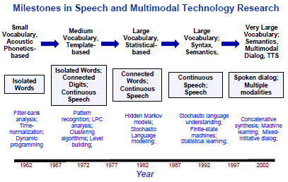
History of ASR: Overview

Slide 11
The variable dimensions of ASR
Vocabulary size
Cardinality of 10 like digits is easy
We need to handle large vocabularies (64k)
Speech
Isolated Word recognition vs continuous speech
Human-to-machine vs human-to-human
Channel
The input cannel generates noise
The context of the speaker too

Slide 12
Large-vocabulary contiuous speech recognition (LVCSR)
Vocabulary size
From 20k to 60k words
Speech
Continuous so we have to segment
Speaker-independent
Channel
Multimedia
Different devices

Slide 13
Architecture of an ASR system
designing the acoustic-language model

Slide 14
Architecture of an ASR system: The Noisy Channel model
Noisy channel metaphore
  Know how the cannel distorts the source
  Then use this knowledge to compute the most likely string over the language which best fits the input
    Best fits the input?? → Metric for similarity
    Over the whole language?? → Efficient search

Slide 15
Architecture of an ASR system
To pick the sentence that best matches the noisy input
  Bayesian inference and HMM
    Each state oh the HMM is a typhe of phone
    The conections put constraints given the lexicon
    Compute the probabilities of transitions in time
The search of that sentence must be efficient
  Viterbi decoding algorithm for HMM

Slide 16
Architecture of an ASR system: Bayesian inference
What is the most likely sentence out of all sentences in the language L given some acoustic input O?
  Acoustic input as a sequence of individual “symbols” or “observations”
  Sentence as a string of words
Bayesian inference to address this problem:
  Likelihood: computed by the acoustic model
  Prior probability: computed by the language model

Slide 17
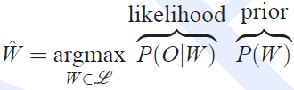
Architecture of an ASR system

Slide 18
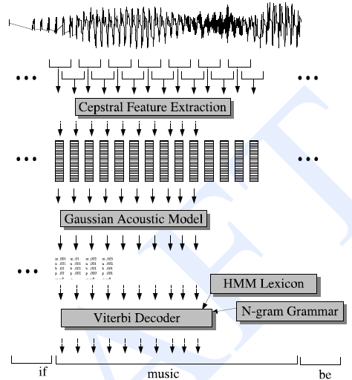

Architecture of an ASR system: The HMM
Feature extraction
  Acoustic waveform is sampled in frames
  Each time window is represented with a vector of features
Gaussian model to compute
  q: a state of the HMM
  o: observation or vector of features
  This is producing a vector of probabilities for each frame
    Each component will be the probability that each pone or subphone correspond to
      these features.
The HMM → Phonetic dictionary or lexicon
  N-gram representation
  Use Viterbi algorithm

Slide 19
The acoustic model
Feautre extraction and likelihood calculation

Slide 20
The acoustic model
Likelihood → Acoustic Model (AM)
  Extract features of the sounds
  The sound is processed and we get a nice representation → MFCS
Gaussian mixture model to compute the likelihood of the representation for a pone (word)
  Compute : a pone or subphone corresponds to a state q in our HMM

Slide 21
Extracting features
Transform the input waveform into a sequece of acoustic feature vectors → MFCC
  Each vector represents the information in a small time window of the signal.
  Common in speech recognition, mel frequency cepstral coefficients
  Based on the idea of cepstrum
First step is convert the analog representations into a digital signal
  Sampling: measure the amplitude at a particular time (sampling rate)
  Quantization: represent and store the samples
We are then ready to extract MFCC features

Slide 22
Extracting features: Pre-emphasis
Input: waveform
Output: the waveform with the high frequencies boosted
Reason: high requencies offer a lot of information

Slide 23
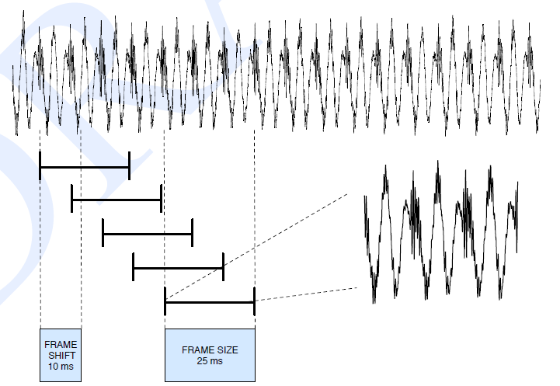
Extracting features: Windowing
Input: waveform with boosted high frequencies
Output: frammed waveform
Reason:
  The waveform changes very quicly
  Properties are not constant through time

Slide 24
Extracting features: Discrete Fourier transform
Input: windowed signal
Output: for each of N discrete frequency bands we get the sound presure
Reason: get new information
  Amount of energy related to the frequency
  Vowels

Slide 25
Extracting features: Mel filter bank and log
Input: information about the amount of energy for a frequency
Output: log (wrapped frequencies)
  Wrapping with mel scale
  Log makes a nice change to interpret data
Reason: interesting frequency bands are in an interval

Slide 26
Extracting features: Inverse Discrete Fourier Transform
Input: information about amount of energy/frequency in the interesting intervals or spectrum
Output: cepstrum or the spectrum of the log of the spectrum (first 12 cepstral values)
Reason: more information
  Usefull processin advantages
  Improves phone recognition
  Vocal tract filter, pitch → consonants

Slide 27
Extracting features: Deltas and energy
Input: cepstral form
Output: deltas for each 12-value cepstral in a window and energy of the window
Reason:
  Energy is useful to detect stops and then sillabes and phones
  Delta → Velocity: represent changes between windows (energy)
  Double delta → Acceleration: change between frames in the corresponding feature of delta

Slide 28
Extracting features: MFCC
12 cepstral coefficients
12 delta cepstral coefficients
12 double delta cepstral coefficients
1 energy coefficient
1 delta energy coefficient
1 double delta energy coefficient
39 MFCC features

Slide 29
Acoustic likelihoods: different approaches
We have to compute the likelihood of these feature vectors given an HMMstate
  Given q and o, get p(o|q) →
For part-of-speech tagging each observation is a discrete symbol
For speech recognition we deal with vectors → discretize??
  Same problem when decoding and training
  We need to get the matrix B and then change the training algorithm.
Different approaches
  Vector quantization
  Gaussian PDF’s
  ANN, SVM, Kernel methods

Slide 30
Acoustic likelihoods: Vector quantization
Useful pedagogical step
  Not used in reality
  Clusterize
  Get prototype vectors
  Compute distances with a metric
        Euclidean
        Mahanabolis
  Train with an algorithm
        Knn
        K-means
  Get the most probably symbol given an observation b(i)

Slide 31

Acoustic likelihoods: Gaussian PDFs
Speech is simply non categorical, symbolic process.
  We must compute the observation probabilities directly on the feature vectors
  Probability densitiy function over space
Unvariate gaussians
  Simplest use of gaussian probability estimator
  Probability: area under the curve = 1
  One gaussian tells us how probable the value of a
  feature is to be generated by an HMM state

Slide 32

Acoustic likelihoods: Gaussian PDFs
Multivariate gaussians
  Single cepstral feature to 39-dimension vector → new dimension
  Use a gaussian for each feature → supposing the distribution
Gaussian mixture models
  A particular cepstral value might have non-normal distribution
  Weighted mixture of multivariate gaussians
  Trained with the Baum-Welch algorithm

Slide 33


Acoustic likelihoods: Probabilities and distance functions
Log Probability is much easy to work with than probability
  Multipliying many probability results in small numbers → underflow
  The log of a number is much easy way to work VS
  Computational speed beacuse we are adding

Slide 34
The language model
N-gram and lexicon

Slide 35
The language model
Prior → The Language Model (LM)
  How likely a string of words is to be a real english sentence
  N-gram approach
We can see the HMM as a net given the lexicon…
  List of words, pronunciation dictionaries
    Accoring to basic phones
  Phonetic resources in the web for several languages
  Usefull in other fields
  More than pronunctiation
    Stress level
    Morphological information
    Part of speech information
    …
…and the N-gram

Slide 36
The language model: Pronunciation lexicon

Slide 37
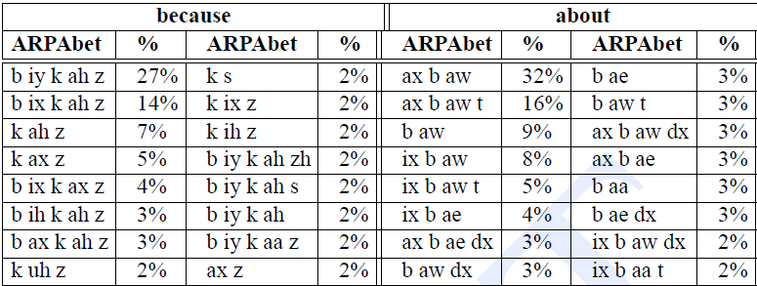
The language model: Pronunciation lexicon

Slide 38
The language model: HMM and Lexicon
Sequences of HMM states concatenated
  Left-to-right HMM
Simple ASR tasks can use a direct representation
For LVCSR we need more granularity because of the changes in the frames
  Phone can reach the second → sampling rate 10ms → 100 frames for a pone (different)

Slide 39
The langauge model: The N-gram
Assign probability to a sentence
3-grams or 4-grams
  Depending on the application
  Depending on the vocabulary size
Working with text we want to know the probability of a Word given some history
Working with speech we want to know the probability of a phone given some history
  Chain-rule probability
  The lenght of the hitory is N
Features also valid for speech recognition

Slide 40
Decoding and searching
Putting all together

Slide 41


Decoding a sentence: join probabilites
We have to combine all the probability estimators to solve the problem of decoding
  Produce the most probable string of words
Modifications are needed in our bayesian inference
  Incorrect Independence assumptions
  We are underestimating the probability of each subphone
  Reweigth the probabilities by adding language model scaling factor
  Reweight requires one more change:
    P(W) has a side-effect as a penalty for inserting words
    A sentence with N words will have language model probability of
    Bag of words, the mord words in the sentence, the more times this penalti is taken and the less probable the sentence will be

Slide 42


Decoding a sentence: Again the HMM
Difficult tasks
HMM
  Set of states
  Matrix A of probabilities
  A set of observation likelihoods
Suppose A and B are trained
  Viterbi algorithm to search efficiently

Slide 43




Searching: The Viterbi algorithm
Possible combinations for the Word “five”
Viterbi trellis
  Represents the probability that the HMM is in state j after seeing the first t observations and passing through the most likely state sequence
  One per state

Slide 44

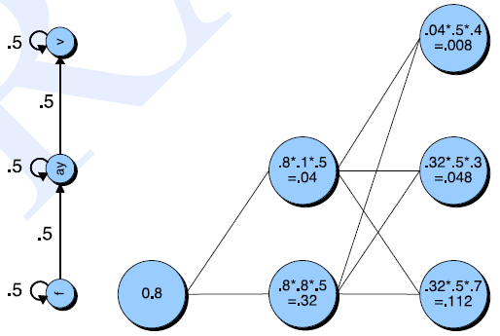
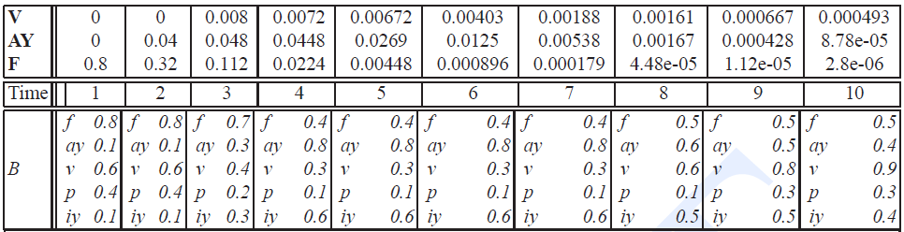
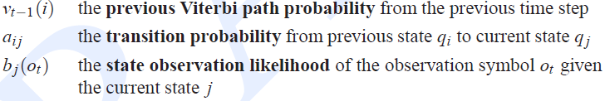
Searching: The Viterbi algorithm

Slide 45
Training
Embedded and viterbi training

Slide 46
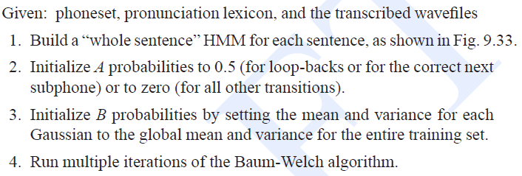
Training: Embedded Training
How an HMM-based speech recognition is trained?
  Simplest → Hand labeled isolated Word
    Train A and B separately
    Phone hand segmented
    Just train by counting in the training set
    Too expensive and slow
  Good way → train each pone HMM ebedded in an entire sentence
    Anyways, hand phone segmentation do play some role
    Transcription and wavefile to train
    Baum-Welch algorithm

Slide 47
Evaluation
Word error rate and mcnemar test

Slide 48
Evaluation: Error Rate
Standar metric → error rate
  Difference between predicted string and expected → Minimum edit distance for WER
Setence error rate
Minimum edit distance by
  Free script available from the National Institute of Standars and Technologies
  Confusion matrices
  Usefull for test if a change in a system is made

Slide 49
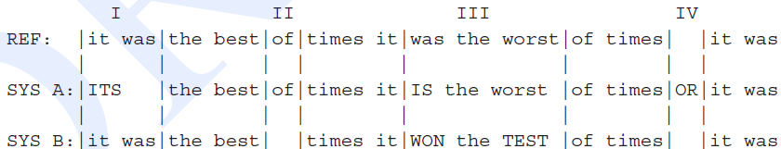
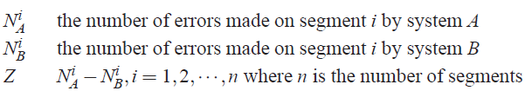
Evaluation: McNemar Test
MAPSSWE or McNemar Test
  Looks at the differences between the number of word errors of the two systems
  Average across a number of segments

Slide 50
Applications of ASR
Principle commercialized applications

Slide 51
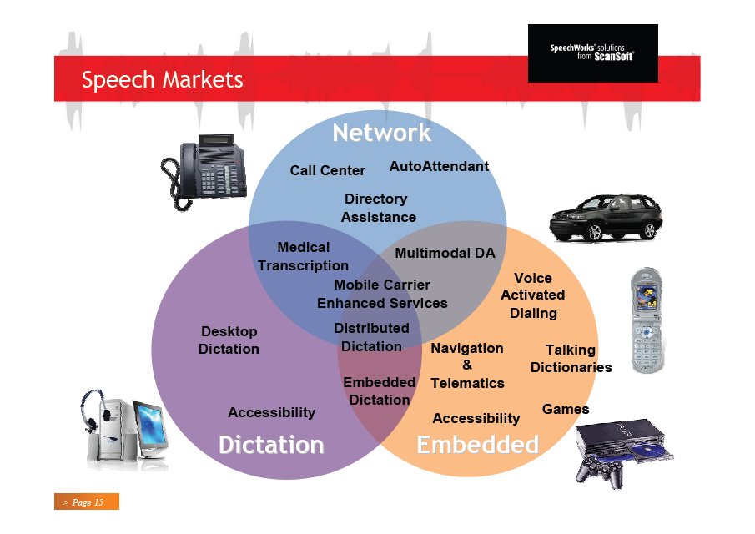
Applications of ASR in:
Telephone IVR
Telphone messaging (tools)
Mobile
Embedded
Desktop
…

Slide 52
Applications of ASR in Telephone IVR
Interactive Voice Response
  Voice prompts + telephone keypad
  Call centers and surveys

Slide 53
Applications of ASR in Telphone messaging (tools)
Conversational telephone systems
  Post-process of the messages
  Simoultaneusly

Slide 54
Applications of ASR in Mobile Devices

Slide 55
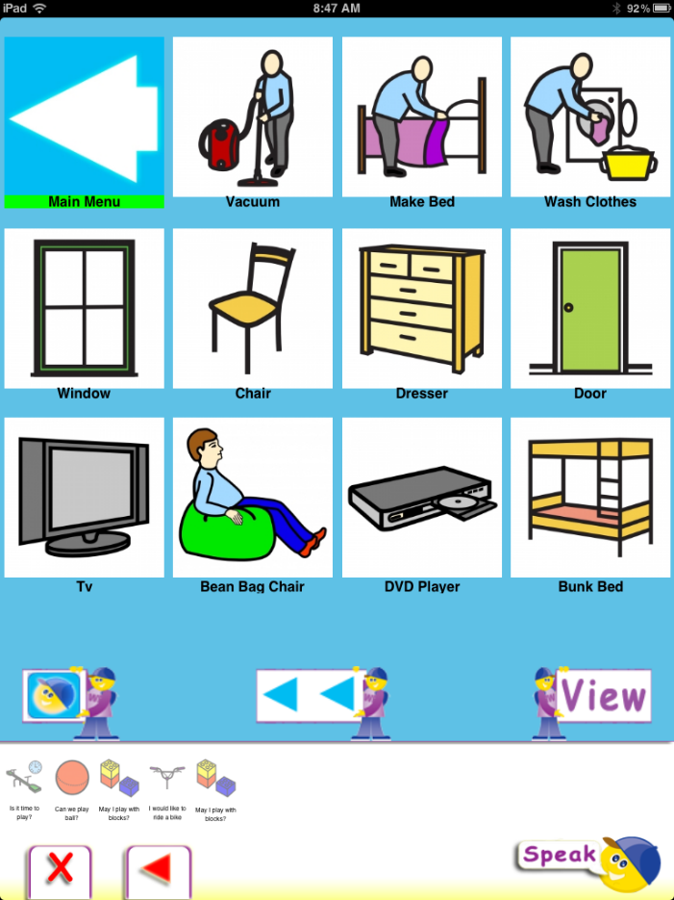
Applications of ASR in Mobile Devices

Slide 56
Applications of ASR in Embedded Systems
Automotive
Game consols
Electronics
Other devices
  Military
  Security

Slide 57
Applications of ASR in Desktop Systems
Speech search
Transcription
Language tools
  Pronunciation correction

Slide 58
Applications of ASR
Warehousing
Healthcare

Slide 59
ASR in the marketplace
Patents and marketprice

Slide 60
Applications of ASR: The market

Slide 61
Applications of ASR: The market

Slide 62
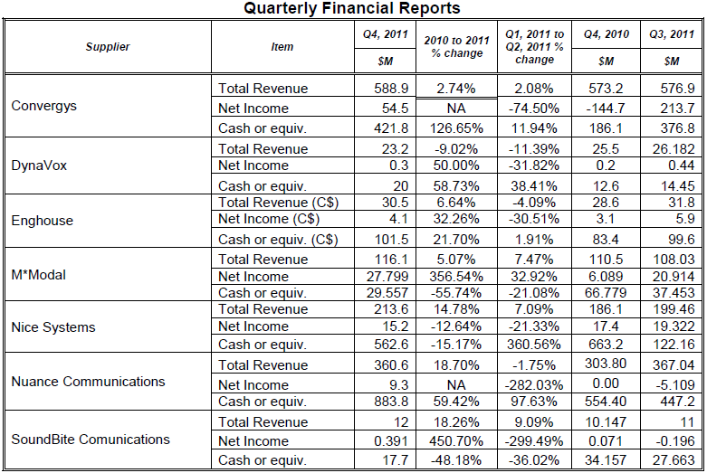
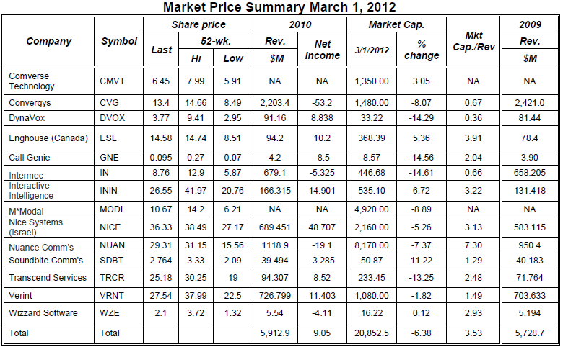
Applications of ASR: The market

Slide 63


Slide 64
Bibliography
ASR News issue: vol.23 no.2 (February 2013)
Automartic Speech Recognition and its application to information extraction
Sadaoki Furui
Automatic Speech Recognition – A Brief History of the Technology
Development
B.H. Juang & Lawrence R. Rabiner
Speech and Language Processing: An introduction to natural language processing, computational linguistics, and speech recognition
Daniel Jurafsky & James H. Martin
Characterization and recognition of emotions from speech using excitation source information
Sreenivasa Rao Krothapalli, Shashidhar G. Koolagudi
Comparing ANN to HMM in implementing limited Arabic vocabulary ASR systems
Yousef Ajami Alotaibi

Slide 65
Bibliography
A Conversational Telephone Messaging System
Chris Schmandt and Barry Arons
Pick To Voice Warehouse Systems
Martin Murray
Embedded Speech Recognition: State-of-art & Current Challenges
Christophe Couvreur

