Slide 1

Natural Language Processing
Università di Pisa
Giuseppe Attardi
Dipartimento di Informatica
Università di Pisa

Slide 2
Goal of NLP
Computers would be a lot more useful if they could handle our email, do our library research, chat to us …
But they are fazed by natural languages
  Or at least their programmers are … most people just avoid the problem and get into XML, or menus and drop boxes, or …
Big challenge
  How can we teach language to computers?
  Or help them learn it as kids do?

Slide 3

NL: Science Fiction
Star Trek
  universal translator: Babel Fish
  Language Interaction

Slide 4
Early history of NLP: 1950s
Early NLP (Machine Translation) on machines less powerful than pocket calculators
Foundational work on automata, formal languages, probabilities, and information theory
First speech systems (Davis et al., Bell Labs)
MT heavily funded by military – a lot of it was just word substitution programs but there were a few seeds of later successes, e.g., trigrams
Little understanding of natural language syntax, semantics, pragmatics
Problem soon appeared intractable

Slide 5
Recent Breakthroughs
Watson at Jeopardy! Quiz:
  http://www.aaai.org/Magazine/Watson/watson.php
  Final Game
  PBS report
Google Translate on iPhone
  http://googleblog.blogspot.com/2011/02/introducing-google-translate-app-for.html
Apple SIRI

Slide 6
Smartest Machine on Earth
IBM Watson beats human champions at TV quiz Jeopardy!
State of the art Question Answering system

Slide 7
Apple SIRI
ASR (Automated Speech Recognition) integrated in mobile phone
Special signal processing chip for noise reduction
SIRI ASR
Cloud service for analysis
Integration with applications

Slide 8
Google Voice Actions
Google: what is the population of Rome?
Google: how tall is Berlusconi
How old is Lady Gaga
Who is the CEO of Tiscali
Who won the Champions League
Send text to Gervasi Please lend me your tablet
Navigate to Palazzo Pitti in Florence
Call Antonio Cisternino
Map of Pisa
Note to self publish course slides
Listen to Dylan

Slide 9
Technological Breakthrough
Machine learning
Huge amount of data
Large processing capabilities

Slide 10
Unreasonable Effectiveness of Data
Halevy, Norvig, and Pereira argue that we should stop acting as if our goal is to author extremely elegant theories, and instead embrace complexity and make use of the best ally we have: the unreasonable effectiveness of data.
A simpler technique on more data beat a more sophisticated technique on less data.
Language in the wild, just like human behavior in general, is messy.

Slide 11
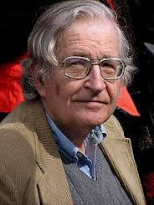

Scientific Dispute: is it science
Prof. Noam Chomsky, Linguist, MIT
Peter Norvig, Director of research, Google

Slide 12
Chomsky
It's true there's been a lot of work on trying to apply statistical models to various linguistic problems. I think there have been some successes, but a lot of failures. There is a notion of success ... which I think is novel in the history of science. It interprets success as approximating unanalyzed data.
http://norvig.com/chomsky.html

Slide 13
Norvig
I agree that engineering success is not the goal or the measure of science. But I observe that science and engineering develop together, and that engineering success shows that something is working right, and so is evidence (but not proof) of a scientifically successful model.
Science is a combination of gathering facts and making theories; neither can progress on its own. I think Chomsky is wrong to push the needle so far towards theory over facts; in the history of science, the laborious accumulation of facts is the dominant mode, not a novelty. The science of understanding language is no different than other sciences in this respect.
I agree that it can be difficult to make sense of a model containing billions of parameters. Certainly a human can't understand such a model by inspecting the values of each parameter individually. But one can gain insight by examining the properties of the model—where it succeeds and fails, how well it learns as a function of data, etc.

Slide 14
Norvig (2)
Einstein said to make everything as simple as possible, but no simpler. Many phenomena in science are stochastic, and the simplest model of them is a probabilistic model; I believe language is such a phenomenon and therefore that probabilistic models are our best tool for representing facts about language, for algorithmically processing language, and for understanding how humans process language.
I agree with Chomsky that it is undeniable that humans have some innate capability to learn natural language, but we don't know enough about that capability to rule out probabilistic language representations, nor statistical learning. I think it is much more likely that human language learning involves something like probabilistic and statistical inference, but we just don't know yet.

Slide 15
Linguistic Analysis
Two reasons:
  Exploiting digital knowledge
  Communicating with computer assistants

Slide 16
Why to study human language?

Slide 17
AI is fascinating since it is the only discipline where the mind is used to study itself
Luigi Stringa, direttore FBK

Slide 18
Language and Intelligence
“Understanding cannot be measured by external behavior; it is an internal metric of how the brain remembers things and uses its memories to make predictions”.
“The difference between the intelligence of humans and other mammals is that we have language”.
  Jeff Hawkins, “On Intelligence”, 2004

Slide 19
Hawkins’ Memory-Prediction framework
The brain uses vast amounts of memory to create a model of the world. Everything you know and have learned is stored in this model. The brain uses this memory-based model to make continuous predictions of future events. It is the ability to make predictions about the future that is the crux of intelligence.

Slide 20
More …
“Spoken and written words are just patterns in the world…
The syntax and semantics of language are not different from the hierarchical structure of everyday objects.
We associate spoken words with our memory of their physical and semantic counterparts.
Through language one human can invoke memories and create next justapositions of mental objects in another human.”

Slide 21
Exploiting Knowledge
Reason 1

Slide 22
Scientia Potentia Est
But only if you know how to acquire it …
The Economist, May 8, 2003
Knowledge Management
Requires
  Repositories of knowledge
  Mechanism for using knowledge

Slide 23
Limitations of Desktop Metaphor
Reason 2

Slide 24
Personal Computing
Desktop Metaphor: highly successful in making computers popular
Benefits:
  Point and click intuitive and universal
Limitations:
  Point and click involves quite elementary actions
  People are required to perform more and more clerical tasks
  We have become: bank clerks, typographers, illustrators, librarians

Slide 25
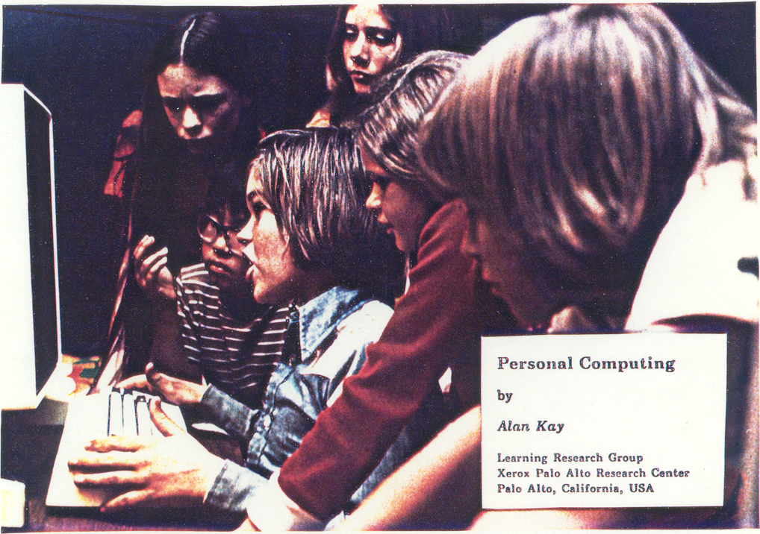

Slide 26

The DynaBook Concept

Slide 27
Kay’s Personal Computer
A quintessential device for expression and communication
Had to be portable and networked
For learning through experimentation, exploration and sharing

Slide 28

Alan Kay: Laurea ad honoris

Slide 29
An Ordinary Task
Add a table to a document with results from latest benchmarks and send it to my colleague Antonio
7-8 point&click just to get to the document
dozen point&click to get to the data
lengthy fiddling with table layout
3-4 point&click to retrieve mail address
etc.

Slide 30
Prerequisites
Declarative vs Procedural Specification
Details irrelevant
Many possible answers: user will choose best

Slide 31
Going beyond Desktop Metaphor
Could think of just one possibility:
  Raise the level of interaction with computers
How?
Could think of just one possibility:
  Use natural language

Slide 32
Linguistic Applications
So far self referential: from language to language
  Classification
  Extraction
  Summarization
More challenging:
  Derive conclusion
  Perform actions

Slide 33
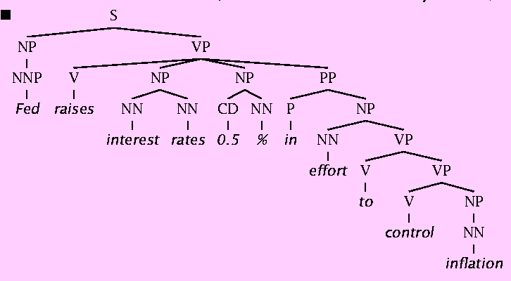
Natural Language Understanding is difficult
The hidden structure of language is highly ambiguous
Structures for: Fed raises interest rates 0.5% in effort to control inflation (NYT headline 5/17/00)
Slide by C. Manning

Slide 34
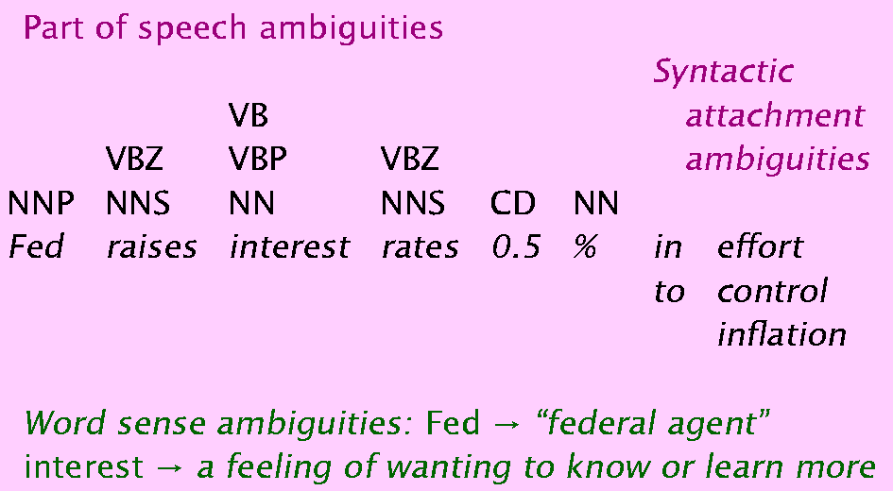
Where are the ambiguities?
Slide by C. Manning

Slide 35
Newspaper Headlines
Minister Accused Of Having 8 Wives In Jail
Juvenile Court to Try Shooting Defendant
Teacher Strikes Idle Kids
China to Orbit Human on Oct. 15
Local High School Dropouts Cut in Half
Red Tape Holds Up New Bridges
Clinton Wins on Budget, but More Lies Ahead
Hospitals Are Sued by 7 Foot Doctors
Police: Crack Found in Man's Buttocks

Slide 36
Reference Resolution
U: Where is The Green Hornet playing in Mountain View?
S: The Green Hornet is playing at the Century 16 theater.
U: When is it playing there?
S: It’s playing at 2pm, 5pm, and 8pm.
U: I’d like 1 adult and 2 children for the first show.
How much would that cost?
Knowledge sources:
  Domain knowledge
  Discourse knowledge
  World knowledge

Slide 37
NLP hard
Natural language is:
  highly ambiguous at all levels
  complex and subtle use of context to convey meaning
  fuzzy?, probabilistic
  involves reasoning about the world
  a key part of people interacting with other people (a social system):
    persuading, insulting and amusing them
But NLP can also be surprisingly easy sometimes:
  rough text features can often do half the job

Slide 38
Hidden Structure of Language
Going beneath the surface…
  Not just string processing
  Not just keyword matching in a search engine
    Search Google on “tennis racquet” and “tennis racquets” or “laptop” and “notebook” and the results are quite different …
    though these days Google does lots of subtle stuff beyond keyword matching itself
  Not just converting a sound stream to a string of words
    Like Nuance/IBM/Dragon/Philips speech recognition
To recover and manipulate at least some aspects of language structure and meaning

Slide 39
About the Course
Assumes some skills…
  basic linear algebra, probability, and statistics
  decent programming skills
  willingness to learn missing knowledge
Teaches key theory and methods for Statistical NLP
  Useful for building practical, robust systems capable of interpreting human language
Experimental approach:
  Lots of problem-based learning
  Often practical issues are as important as theoretical niceties

Slide 40
Experimental Approach
Formulate Hypothesis
Implement Technique
Train and Test
Apply Evaluation Metric
If not improved:
  Perform error analysis
  Revise Hypothesis
Repeat

Slide 41
Program
Introduction
  History
  Present and Future
  NLP and the Web
Mathematical Background
  Probability and Statistics
  Language Model
  Hidden Markov Model
  Viterbi Algorithm
  Generative vs Discriminative Models
Linguistic Essentials
  Part of Speech and Morphology
  Phrase structure
  Collocations
  n-gram Models
  Word Sense Disambiguation
Preprocessing
  Encoding
  Regular Expressions
  Segmentation
  Tokenization
  Normalization

Slide 42
NLTK
  Introduction to Python
  Overvies of NLTK libraries
Classification
  Machine Learning
  Statistical classifiers
    Bayesan Network
    Perceptron
    Maximum Entropy
    Support Vector Machines
    Hidden Variable Models
Clustering
  K-means
  Factored Models
    Singular Value Decomposition
    Latent Semantic Indexing

Slide 43
Tagging
  Part of Speech
  Named Entity
  Super Senses
Sentence Structure
  Constituency Parsing
  Dependency Parsing
Semantic Analysis
  Semantic Role Labeling
  Coreference resolution
Statistical Machine Translation
  Word-Based Models
  Phrase-Based Models
  Decoding
  Syntax-Based SMT
  Evaluation metrics

Slide 44
Processing Pipelines
  Integrated tooolkit
  Frameworks
    Gate
    UIMA
  Data Pipeline
    Tanl
Applications
  Information Extraction
  Information Filtering
  Recommender System
  Opinion Mining
  Semantic Search
  Question Answering
    Text Entailment

Slide 45
Exam
Project

Slide 46
PreviousYear Projects
Participation to Evalita 2011
  Task POS + Lemmatization: 1st position
  Task Domain Adaptation: 1st position
  Task SuperSense: 1st position
  Task Dependency Parsing: 2nd position
  Task NER: 3rd position

Slide 47
Books
C. Manning, H. Schutze. Foundations of Statistical Natural Language Processing. MIT Press, 2000.
D. Jurafsky, J.H. Martin, Speech and Language Processing. 2nd edition, Prentice-Hall, 2008.
S. Kubler, R. McDonald, J. Nivre. Dependency Parsing. 2010.
P. Koehn. Statistical Machine Translation. Cambridge University Press, 2010.
S. Bird, E. Klein, E. Loper. Natural Language Processing with Python

